Slide 1
GCSE Geography Revision

Slide 2
Structure of the exam.
Paper 1 – Living with the Physical environment.
Marks 88
Time – 1.30h
Paper 2 – Living with a human environment
Marks 63
Paper 3 – Geographical Application
Marks 56
Time – 1h
Time – 1.15h
Topics
Hazards (Tectonic hazards, weather hazards, climate hazards)
A Living World (Tropical Rainforests, Cold Environments)
UK Landscapes (Rivers and Coasts)
Topics
Urban Issues and Challenges
Resources Management
Energy
Topics
Pre-release material
Application of fieldwork.
Note the pre-release material is published on 21st March.
Do not answer the economic world unit or the topics food and water topics in the resource management
Do not answer glaciers unit

Slide 3
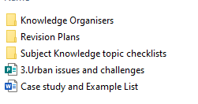

Where can I find resources?
Homework
https://www.aqa.org.uk/subjects/geography/gcse/geography-8035/assessment-resources?f.Resource+type%7C6=Question+papers

Slide 4

Revision Strategies –Read, cover, write, check
Keep the amount of text short.
This is particularly useful for case studies.
Correct in a different colour. – This identifies/ reduces the amount of future revision.

Slide 5
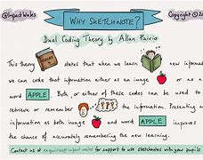
Revision Strategies – Dual coding
If you are able to take information in one format and translate it to another, you MUST understand it.
Scientific research shows that your brain is more likely to retain/ retrieve information if you associated it with an image.

Slide 6

Revision Strategies – Flash cards
One side has the question.
Remember to dual code
Force links between cards
Excellent recall.

Slide 7

Quick Wins
Focus on key vocab.
Case Study details.
Longer answer responses
  BUG
  Planning

Slide 8
Pleas to Parents
  Remind your son/ daughter of the topic/ exam on the morning.

