Slide 1
AQA ENGLISH LANGUAGE
ADVANCED LEVEL (GCE)

Slide 2
English Language
The study of language in different social contexts, both modern and historical
(Exploring texts which raise issues and explore viewpoints in relation to these contexts, using subject specific terminology to explore this and applying established theory to connect with and illuminate individual ideas)

Slide 3
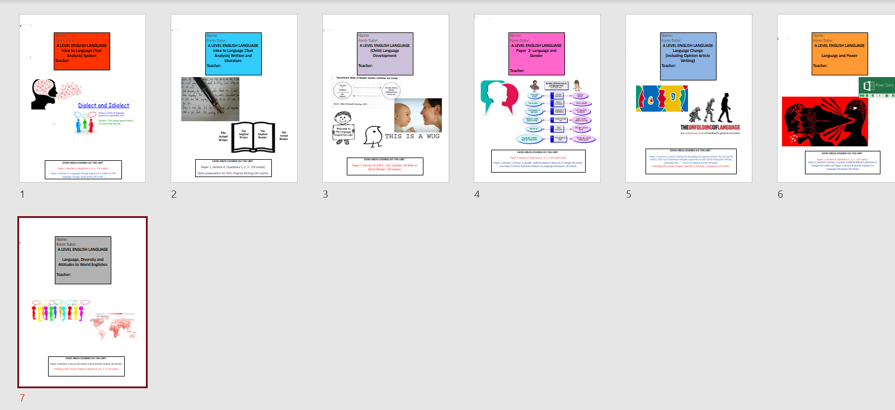
Study over the two years has been divided into topics placing language in these social contexts
Written Texts, Spoken Texts (introductory units) Gender, Power, Change, Diversity and Global English and Child Language Development
Students have an organised set up of exercise book for each topic plus revision books to revisit these topics.

Slide 4
Completed by all 12 students in the class
2x Non-Examined Assessment Pieces- Language in Action
Original (Creative) Writing and Commentary (BD)
2) Research (Data) and Written Language Investigation (LT)
This is marked internally and will be sent to the exam board for moderation in May 2022
The pieces together are worth 20 % of the overall grade
Quick wins ahead of the mocks - what are the essential things to do between now and March 4th.
Longer-term revision strategies and the resources that can be used in conjunction with these.
Advice for parents on how they can best help students to revise.

Slide 5
80% of the qualification is assessed by exam
2 papers and 5 different question types
(all require different skills and approaches)
Paper 1- Language the Individual and Society
Paper 2 – Language Diversity and Change
Any of the topics studied in the exercise books could come up across these papers
Students need to revise KNOWLEDGE of all topics as advanced information has not given indication as to which topics could come up.
The organised system of exercise book has been set up to facilitate this- how organised are students in the keeping of their notes across these 7 exercise books?

Slide 6
Revision strategies: Revising KNOWLEDGE (Content)
Mini tasks provided by LT/BD (Photocopies of revision guides, text books and in-house materials that require recall of the knowledge linked to these topics- including terminology e.g. booklet for February half term.) Texts related to these topics (newspaper, magazine and online articles, reviews, posters, leaflets, advertisements etc.)
Look, Cover, Write and Check
Dual-coding Diagrams
Mind-mapping
Flashcards for shared revision/colour-coded post-its
Creating a timetable in relation to revisiting of the topics
Materials around the house- where can the visual resources be viewed regularly? What kind of study space is this happening in?

Slide 7
Misconceptions around Revision
Don’t waste time making notes look too pretty
Don’t just copy knowledge out in lists or spider diagrams- there needs to be processing and reflection
Don’t think doing it once is enough- Do therefore check over materials after completion- transfer can sometimes allow for error in content and spelling- don’t undo the good work already done.

Slide 8
What information has been shared by the exam board that can help students focus their revision in terms of revising KNOWLEDGE?
One section on each paper requires students to respond to texts they have not seen before. The genre of each of the texts has been specified in advance

Slide 9
Therefore, students are at some advantage about how to apply their knowledge and what sort of issues and viewpoints might be raised through these texts.
Paper 1: Language, the individual and society (Representations)
Text A: News Article- any topic- modern or historical. News meaning something newsworthy- a controversial issue? An issue to be celebrated? Must be connected to the issues and ideas (representations) made by text B- the cook book-so a gender based text in some way?
Text B: Cook Book- could be old or new- representations linked to the domestic space, gender stereotypes and power assigned through language? The breaking of these stereotypes? New diversities in cooking or changes over time?
In school, revision and the mock exam texts selected, will deal with this potential representations, issues and contexts. Revit texts, theory and terminology in exercise books at home that connect with these ideas. What other reading is out there?

Slide 10
Therefore, students are at some advantage about how to apply their knowledge and what sort of issues and viewpoints might be raised through these texts.
Paper 2: Language, Diversity and Change (Viewpoints on a Language Issue)
Text A: Opinion article- one sided bias in terms of viewpoint? Controversial or innovative and forward thinking viewpoint. An established opinion that’s hard to shake off?
Text B: Two opposing side to an argument- Differing opinions might suggest a controversial issue- perhaps technology or social media? Manners? Other media influences- the language of film? What are hot topics when it comes to language and how its diversifying and changing? Is this text less biased than the other as it covers two sides?
In school, revision and the mock exam texts selected, will deal with this potential viewpoints, issues and contexts. Revit texts, theory and terminology in exercise books at home that connect with these ideas. What other reading is out there?

Slide 11
Revising SKILLS: Applying the knowledge requires skills with language on the part of the student
These skills vary according to the question (task type)
Paper 1: Language, the individual and society (Representations) 2h 30m
Section A: Two unseen texts to write about individually and compare (genres specified in advance material). One old, one new- how language creates issues is the focus- what are the details of the issue and how is language used to create these different parts to the issue? There will be social commentary here- what’s going on with these individuals and the society they represent? Terminology need to be applied to the language and selected quotes to explain this. (3 questions 1h30m) GASP 3 questions 70 marks
Section B: A transcript featuring the talk of a young child up to 11 years, usually interacting with other children and/or caregivers. A statement is given declaring an idea about how children typically learn to talk. Does the transcript support this- what is your view in relation to this? One question on a transcript – 1h,( Can also be done on written language- option for alternative question) Line of argument 6 paragraph specific structure- 30 marks.
MULTIPLE EXAMPLE RESPONSES HAVE BEEN EXAMINED, PLANNED, WRITTEN, ASSESSED, IMPROVED
Re-read these, annotate them, improve them further, explore where you went wrong via the feedback, complete equivalent questions and submit/self- assess. Bring to Tuesday evening revision sessions.

Slide 12
Revising SKILLS: Applying the knowledge requires skills with language on the part of the student
These skills vary according to the question (task type)
Paper 2: Language, diversity and change (Viewpoints) 2h 30m
Section A: Evaluate essay- evaluate the idea that . . . (currently the strongest response across the class. Learn examples and knowledge from across the topics- anything could come up.) Line of argument and 5 paragraph structure. (50mins) 30 marks
Section B:
Part 1: Compare the viewpoints in two articles (genres specified in advance material) written about a language issue. Decide on how the two articles are similar and different and how language is used to present what the writer feels and thinks about this subject . Intro plus 2x PETRED Comparison paragraphs (50 mins) 40 marks
Part 2: Write your own viewpoint article on the same topic as above. Very specific established paragraphing and sentence examples given to memorise. (50 mins) 30 marks
MULTIPLE EXAMPLE RESPONSES HAVE BEEN EXAMINED, PLANNED, WRITTEN, ASSESSED, IMPROVED
Re-read these, annotate them, improve them further, explore where you went wrong/what you did well via the feedback, complete equivalent questions and submit/self- assess. Bring to Tuesday evening revision sessions.

Slide 13
Students-Quick Wins for Now
Go through this powerpoint with your parent(s) and discuss your shared understanding of it. Repeat with classmates.
Learn a wider range of terminology- sound sophisticated and know what features to look for. Terminology and task revision booklet for February half term but it’s all in your books.
When you write anything, take care with the basics of capital letters, punctuation and spelling- it matters.
Use the exercise books as your primary revision tool- but process the knowledge and skills in there- don’t just read it all again.
Be an interested reader- be socially aware- read news and articles online as a habit- read what you’ve been given in school again/properly and read what’s around you- seek it out and take the time to think about the issues and viewpoints raised- on your own and discuss it with others.
Be organised, bring the correct materials and submit work on time. Be prepared to sacrifice more time to revision if you want to improve outcomes

Slide 14
Thank you

