Slide 1
A Level Maths Revision
Mrs Lorna Rawnsley

Slide 2
Programme so far and leading to the mocks

Slide 3
Revision Sessions – Monday Evenings after school
Short recap of topic covered – what do I need to know?
Practise of key skills – modelling
Complete exam pack

Slide 4
Useful Websites

Slide 5
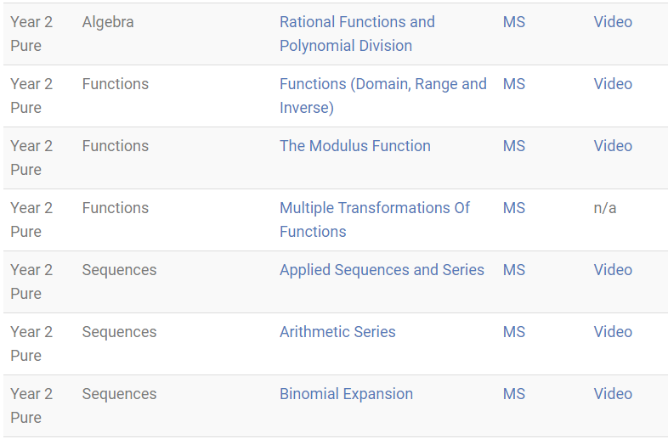

Slide 7
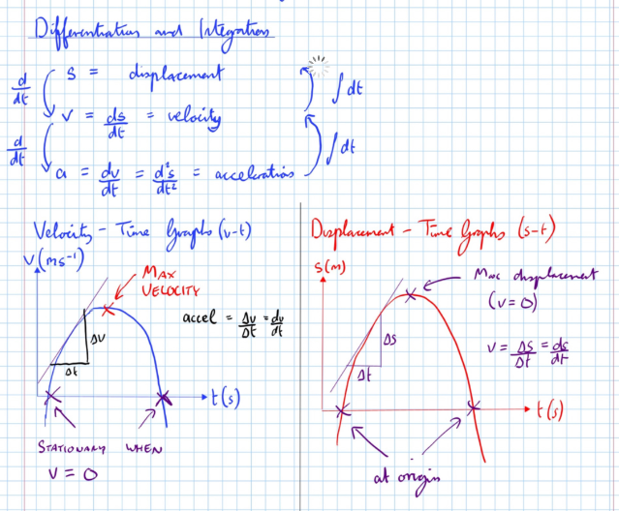

Slide 8
Solutionbanks for all textbook exercises
All past papers (not many for 2017 syllabus)
MadasMaths paper with full written solutions – currently setting one per week

Slide 9
How to revise?
Once completed all topic review (week 1 of next half term)
Complete exam papers in timed conditions
Complete the paper in extra time (to test what you know but were to slow to complete) in a different colour.
Mark and review your solutions, can you understand now you see the full modelled solution.
Highlight topics still struggling with or that need further practise
Target those topics for next week’s paper. Make notes and complete the mixed exercise in the text book

Slide 10
Where to go for help and extra practise
Teacher support
Videos on ALevelMathsRevision. Youtube for extra explanations
Complete questions from text book
Prior exam questions Physics and Maths Tutor has old questions grouped by topic – still valid
26 papers in total from MadasMaths. Direct from website or held on Maths and Physics Tutor
Review 1 and 2 exercises in text book
Exam papers in back of book

