Slide 1
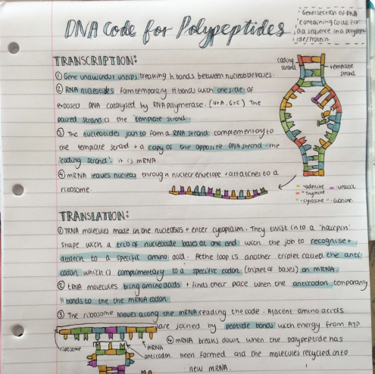
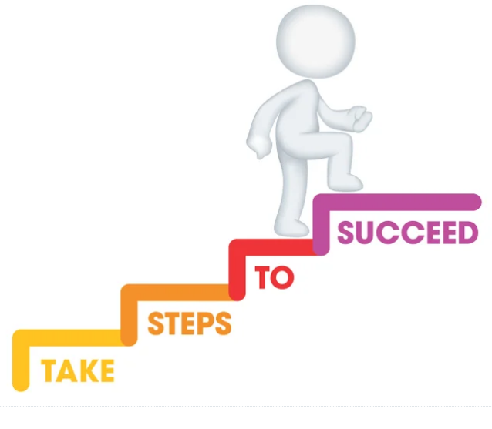
How to revise for GCSE Science

Slide 2
What do we need to do?
How will we do it?
Know
Master
Apply
*Interleve
Grades 7-9

Slide 3
The first time we see information we ‘know’ it, but students must review, revise and consolidate to make sure that they ‘master’ knowledge.
This makes identification of question matter easier in exams and saves time.
Students must explain science using specific scientific vocabulary.

Slide 4
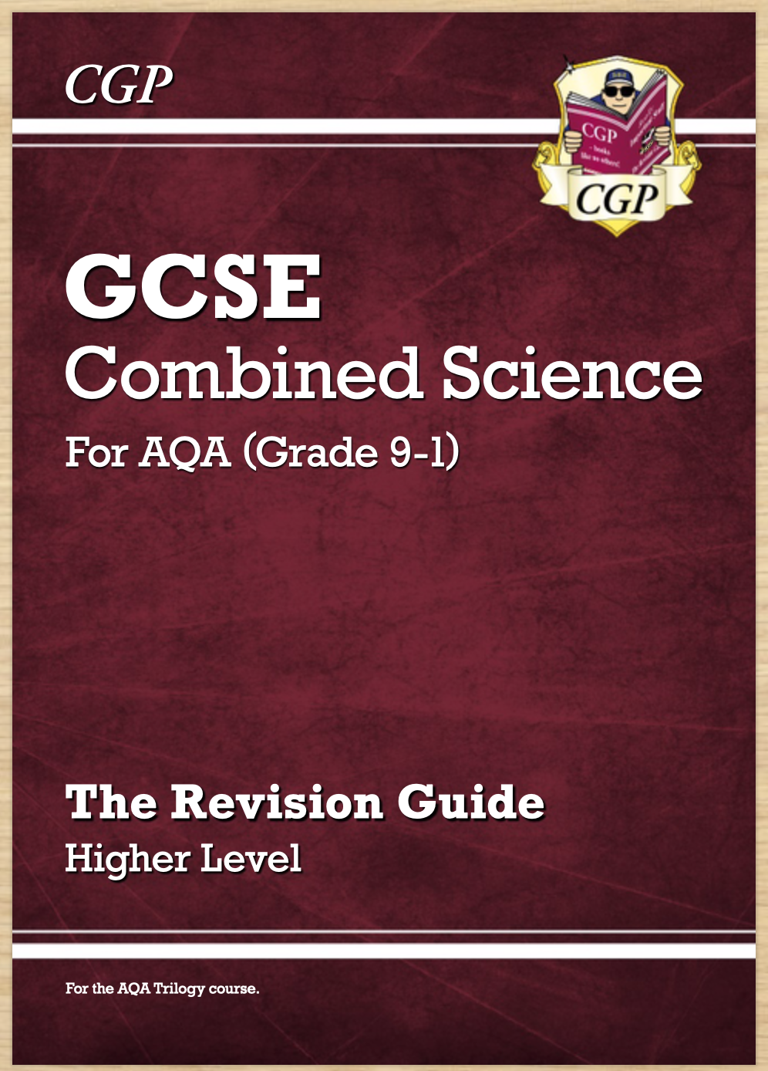
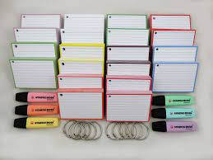
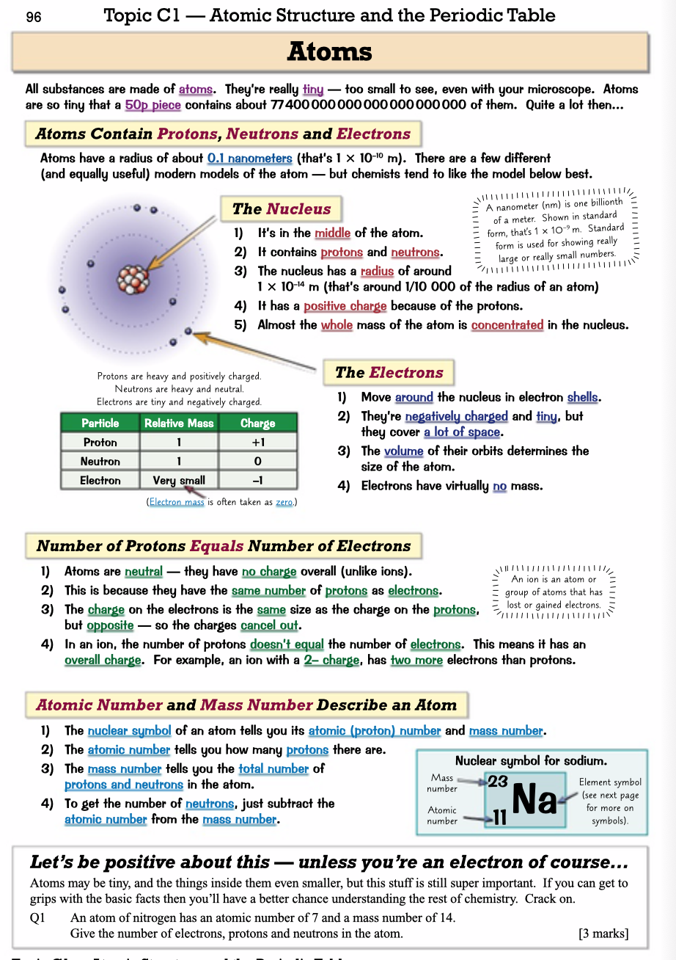
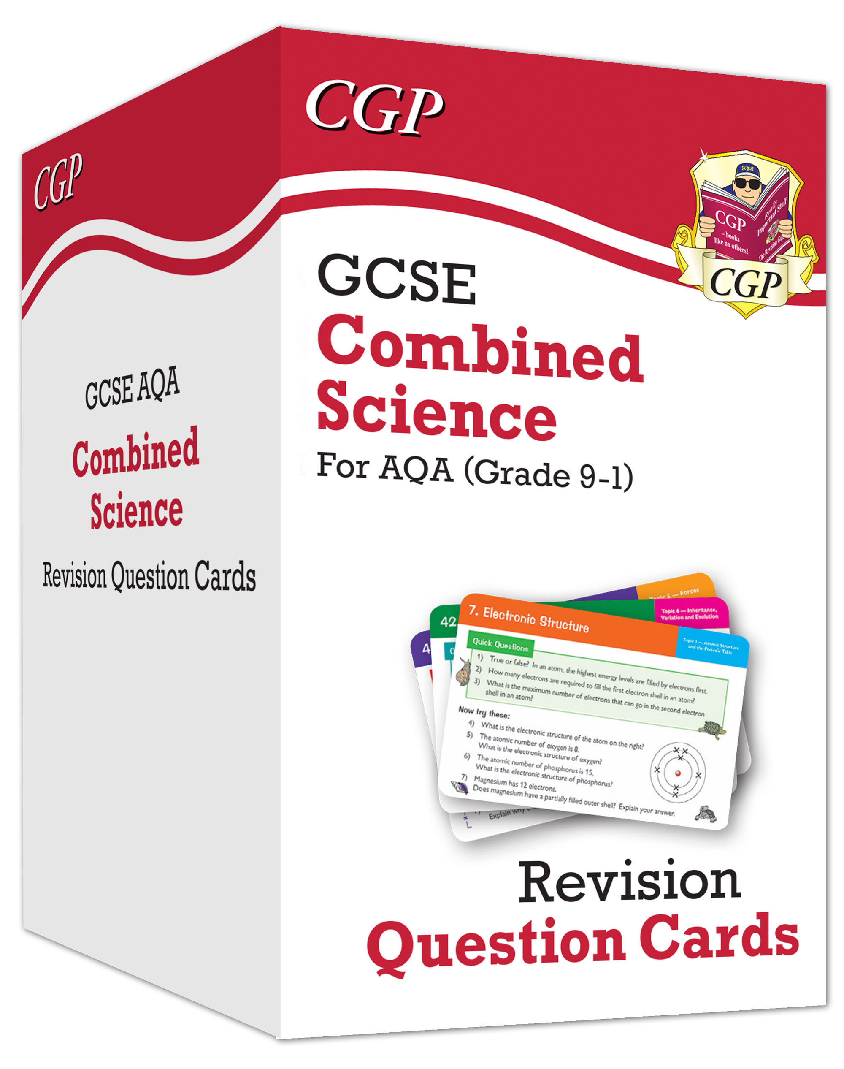
How can students ‘master’ content?
Flashcards
Look, cover, write, check…
Quiz questions

Slide 5
Active note taking involves turning the material into a different format…
Simply copying notes is passive and limited in impact.
Students must process information to ensure active learning.

Slide 6
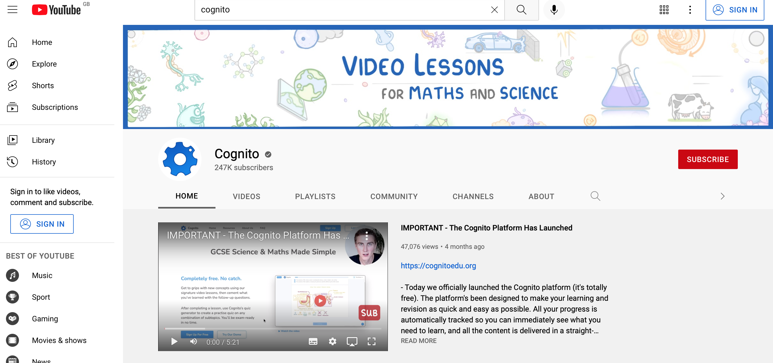
Useful Science Websites…
So many great YouTube channels for you to use, some of our favourites are;
Cognito https://www.youtube.com/c/Cognitoedu
Fuseschool https://www.youtube.com/c/fuseschool/playlists
FreeScienceLessons https://www.youtube.com/c/Freesciencelessons
Required Practicals https://www.youtube.com/channel/UC-TM-z1-tmX1iK_H4SxVhww

Slide 7
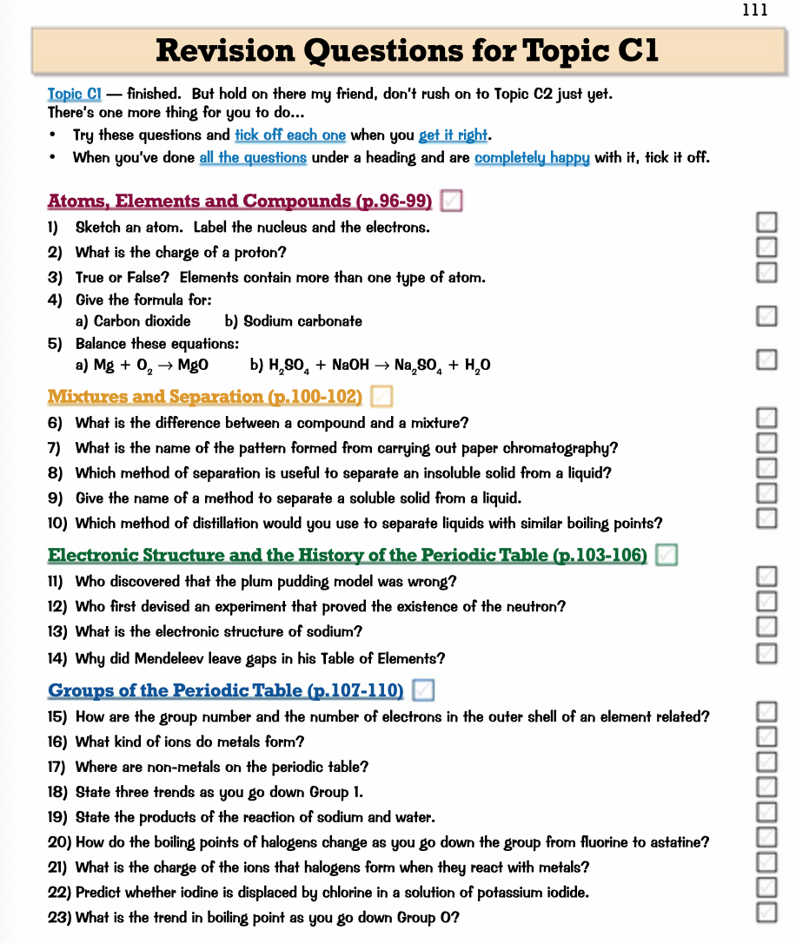

How can students check that they have mastered content?
Quick fact recall questions – revision guide, Educake online, definition checks, YouTube Videos with questions.

Slide 8
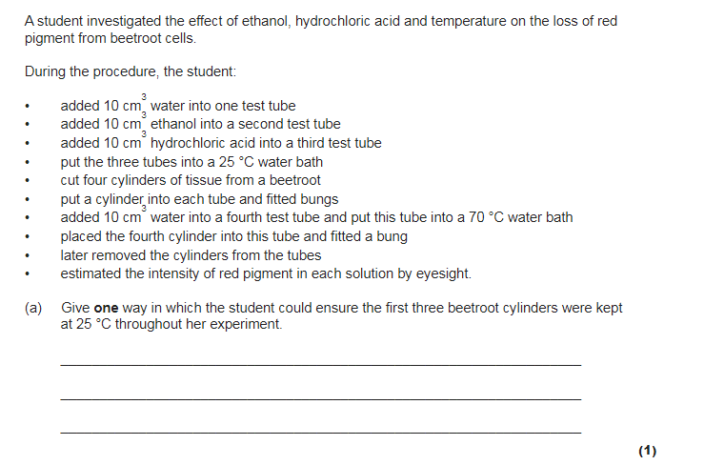
The most important step, applying knowledge to exam questions.
Know
Master
Apply
*Interleve
Grades 7-9

Slide 9
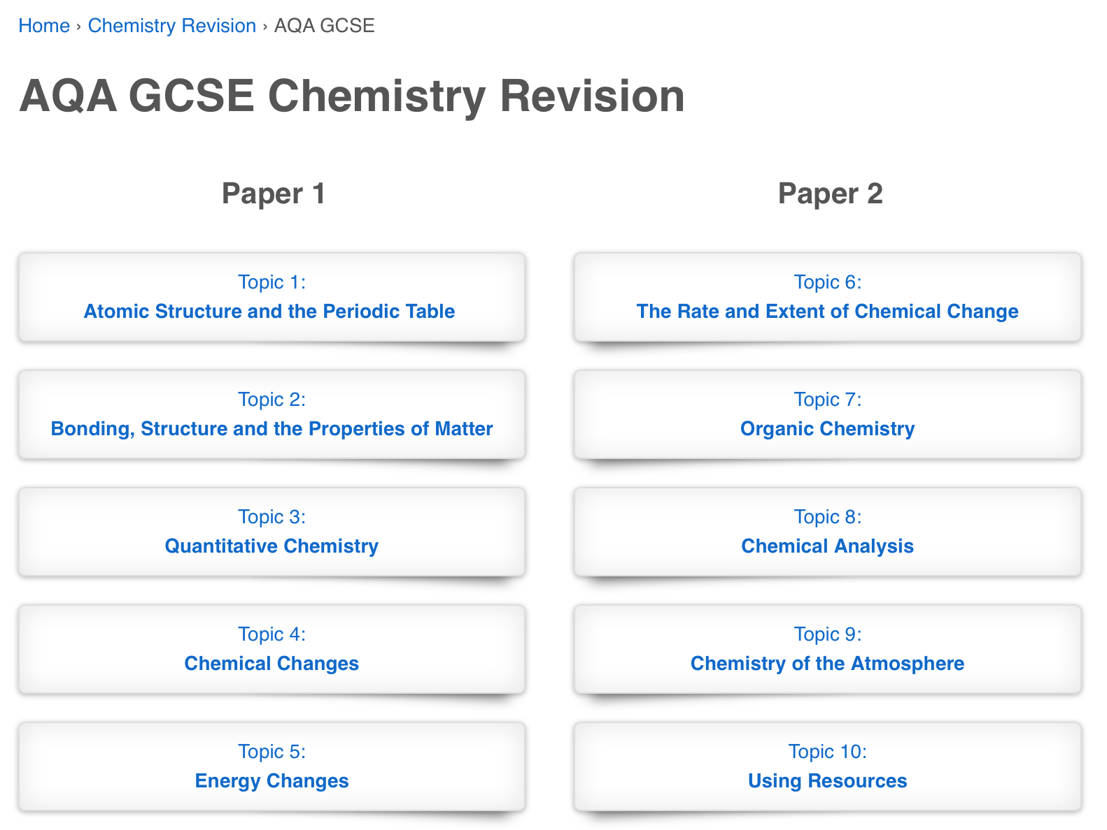
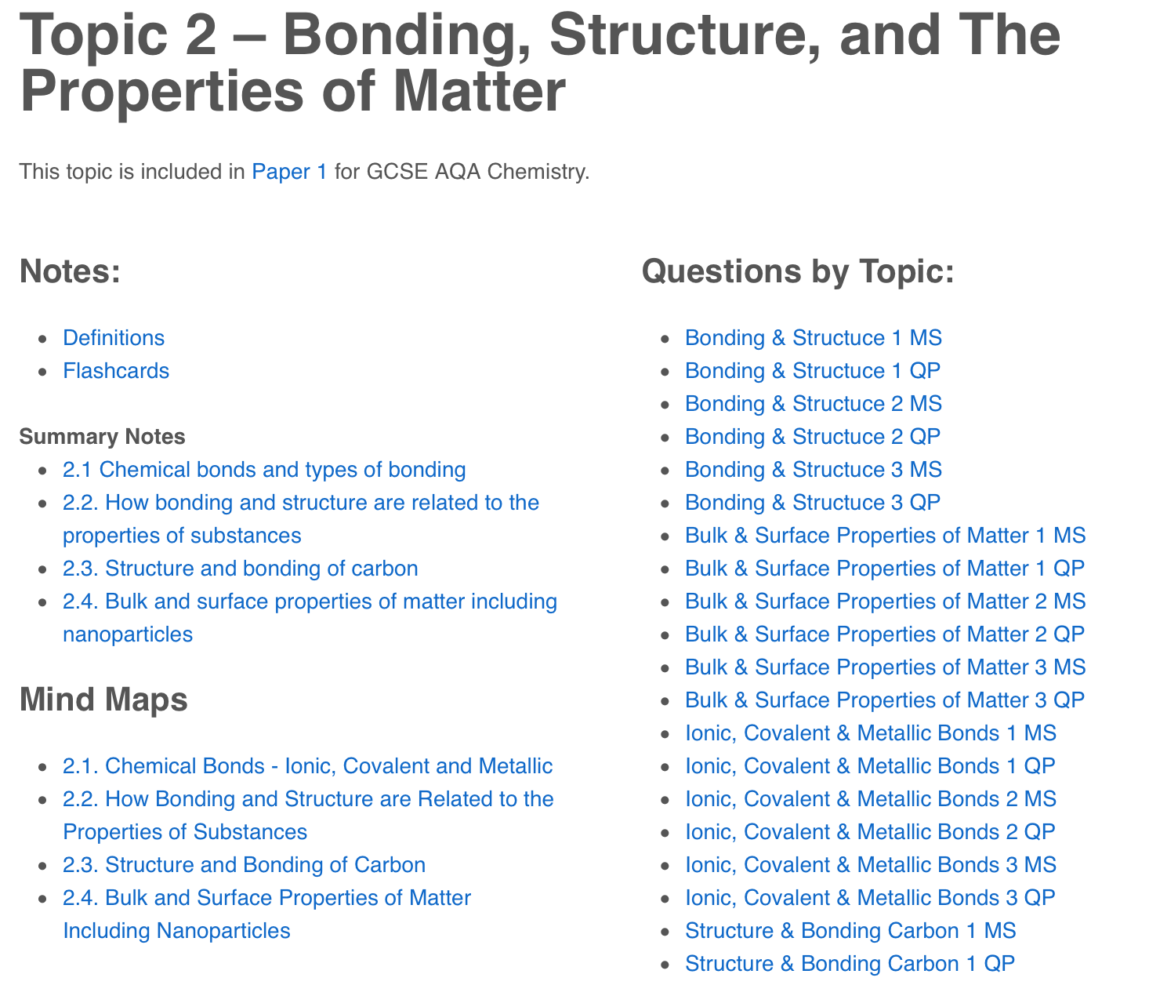
Useful Science Websites…
Physics and Maths Tutor: https://www.physicsandmathstutor.com/
Summary notes, flashcards, mind maps and practise questions for every topic.

Slide 10
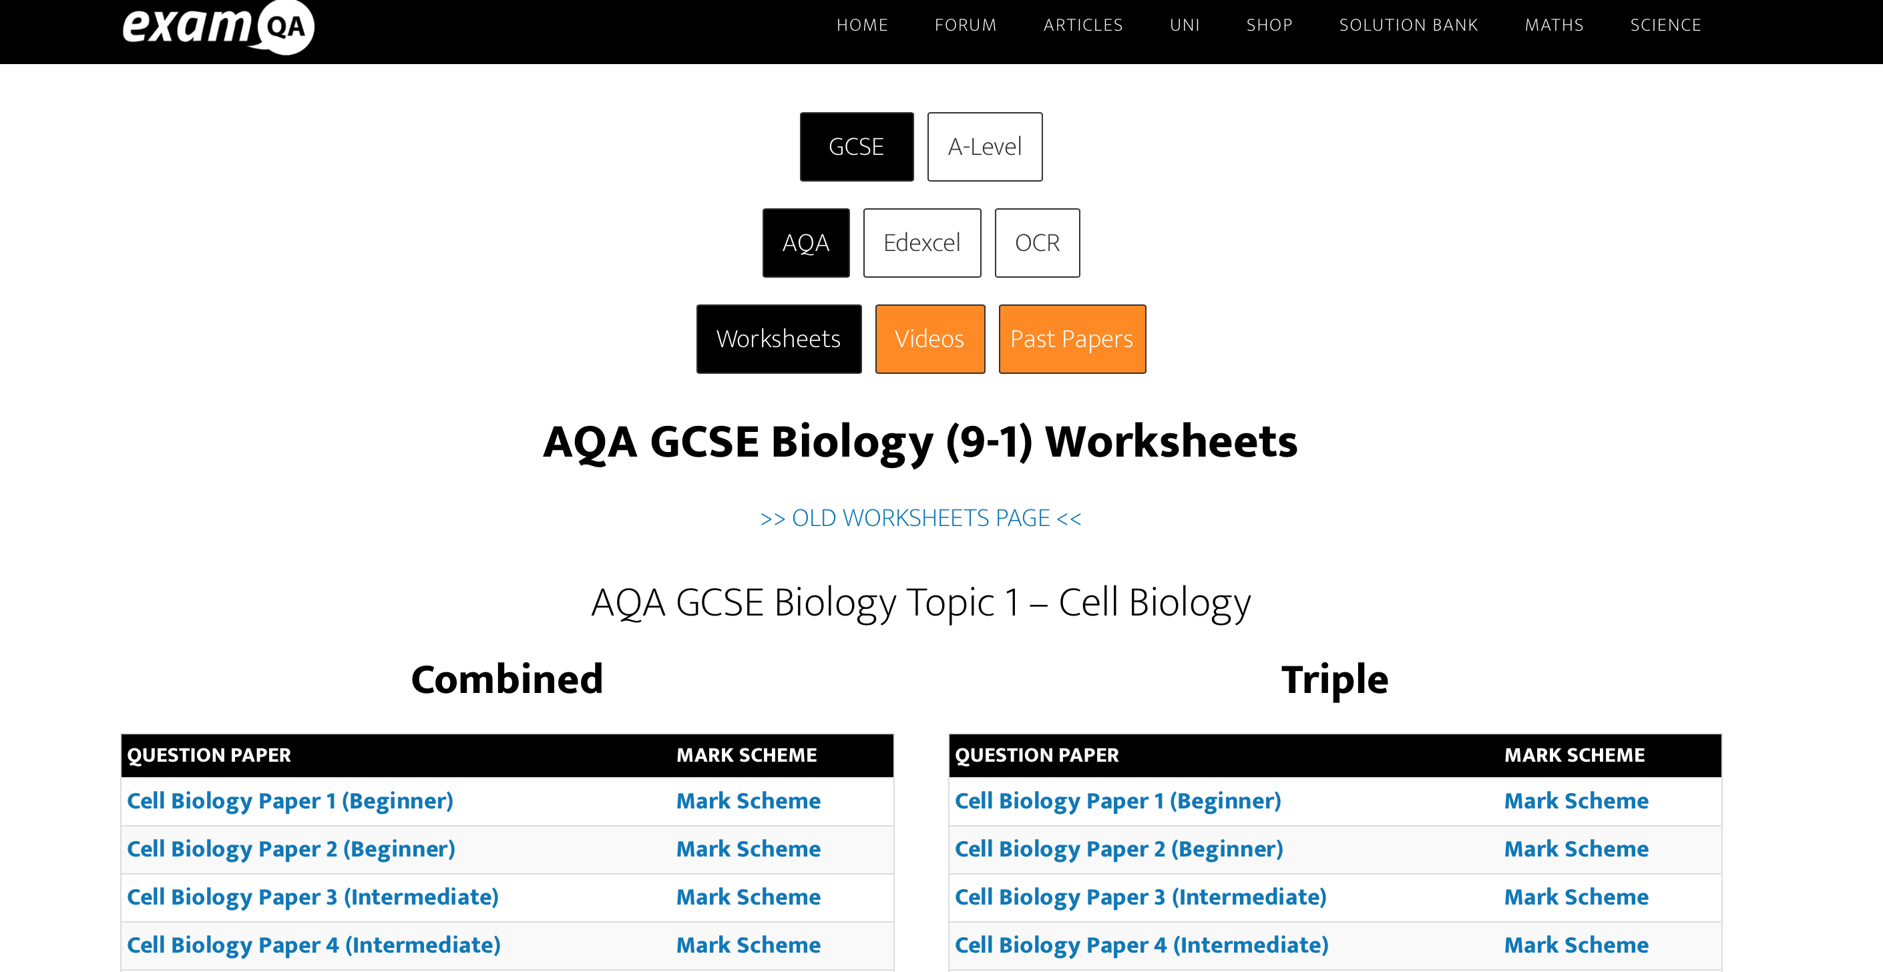
Useful Science Websites…
ExamQA: https://examqa.com/gcse/science/

Slide 11
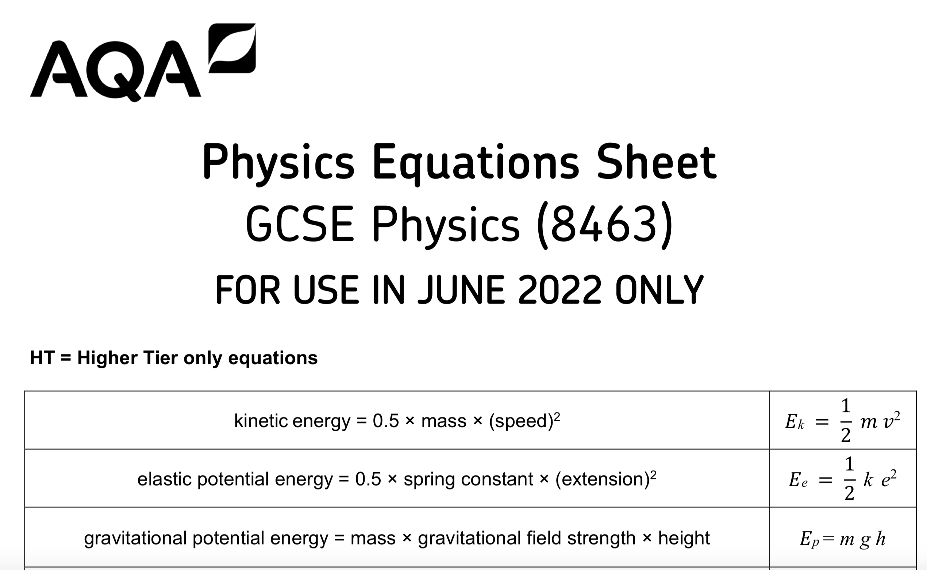
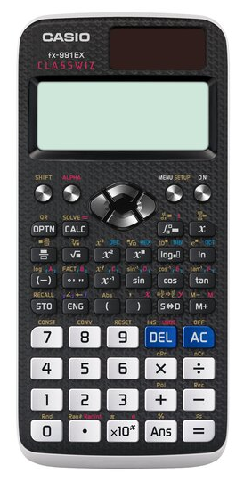
Subtle differences in the specialisms and how we prepare
Biology
Chemistry
Physics
Knowledge
Key terminology
Application
Required Practicals
Knowledge
Key terminology
Application
Required Practicals
Using Periodic Table
Knowledge
Key terminology
Application
Required Practicals
Equation sheet 2022
Units
Calculator required for every science exam!

Slide 12
The key points
Revision needs to involve active strategies (not just reading!)
You cannot do enough past questions – confidence is a big part of this.
Use spaced retrieval and interleaving so that you have to decipher the question content before you begin.

Slide 13
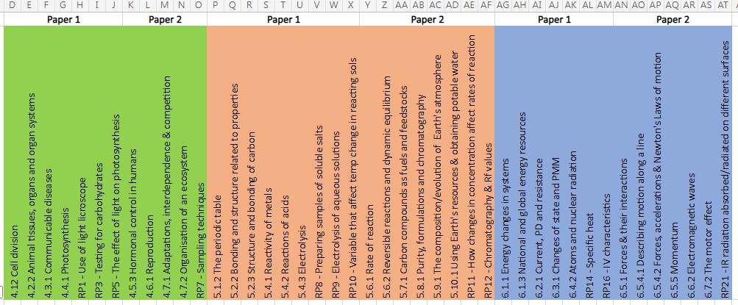
What’s next?
Following mock exams
final work on the ‘hot topics’

Slide 14
AQA Combined Science exams (Summer 2022 update)
– the following will be assessed Foundation Tier
Paper 1
Chemistry
5.1.2 The periodic table
5.2.2 How bonding and structure are related to the properties of substances
5.2.3 Structure and bonding of carbon
5.4.1 Reactivity of metals
5.4.2 Reactions of acids
5.4.3 Electrolysis
Required practicals:
RP8 - Preparation of a pure dry sample of a soluble salt from insoluble oxide or carbonate
RP9 - Electrolysis of aqueous solutions
RP10 - Variables that affect temperature change in reacting solutions
Biology
4.1.2 Cell division
4.2.2 Animal tissues, organs and organ systems
4.3.1 Communicable diseases
4.4.1 Photosynthesis
Required practicals:
RP1 - Use of a light microscope
RP 3 - Testing for carbohydrates
RP 5 - The effect of light on the rate of photosynthesis for pondweed
Physics
6.1.1 Energy changes in a system, and the ways energy is stored before and after such changes
6.1.3 National and global energy resources
6.2.1 Current, potential difference and resistance
6.3.1 Changes of state and the particle model
6.4.2 Atoms and nuclear radiation
Required practicals:
RP14: Specific heat capacity of one or more materials.
RP 16: Investigate the I–V characteristics of a variety of circuit elements, including a filament lamp, a diode and a resistor at constant temperature
Paper 2
Chemistry
5.6.1 Rate of reaction
5.6.2 Reversible reactions and dynamic equilibrium
5.7.1 Carbon compounds as fuels and feedstock
5.8.1 Purity, formulations and chromatography
5.9.1 The composition and evolution of the Earth’s atmosphere
5.10.1 Using the Earth’s resources and obtaining potable water
Required practicals:
RP11 – How changes in concentration affect rates of reaction
RP12 – Chromatography and Rf values
Biology
4.5.3 Hormonal control in humans
4.6.1 Reproduction
4.7.1 Adaptations, interdependence and competition
4.7.2 Organisation of an ecosystem
Required practical's include :
RP7 - Measuring the population size of a common species in a habitat (sampling techniques)
Physics
6.5.1 Forces and their interactions
6.5.4.1 Describing motion along a line
6.5.4.2 Forces, accelerations and Newton's Laws of motion
6.5.5 Momentum
6.6.2 Electromagnetic waves
6.7.2 The motor effect
Required practicals:
RP21 - Investigate how the amount of infrared radiation absorbed or radiated by a surface depends on the nature of that surface

Slide 15
AQA Combined Science exams (Summer 2022 update)
– the following will be assessed Higher Tier
Paper 1
Chemistry
5.2.2 How bonding and structure are related to the properties of substances
5.3.2 Use of amount of substance in relation to masses of pure substances
5.4.1 Reactivity of metals
5.4.2 Reactions of acids
5.4.3 Electrolysis
5.5.1 Exothermic and endothermic reactions
Required practicals:
RP8 - Preparation of a pure dry sample of a soluble salt from insoluble oxide or carbonate
RP9 - Electrolysis of aqueous solutions
RP10 - Variables that affect temperature change in reacting solutions
Biology
4.1.2 Cell division
4.2.2 Animal tissues, organs and organ systems 4.4.1 Photosynthesis
Required practicals :
RP3 - Testing for carbohydrates
RP4 - The effect of changing the pH has on enzymes
RP5 - The effect of light on the rate of photosynthesis for pondweed
Physics
6.1.1 Energy changes in a system, and the ways energy is stored before and after such changes
6.2.4 Energy transfers
6.3.1 Changes of state and the particle model
6.3.3 Particle model and pressure
6.4.1 Atoms and isotopes
6.4.2 Atoms and nuclear radiation
Required practicals:
RP14 - Specific heat capacity
RP16 - Investigate the I–V characteristics of a variety of circuit elements, including a filament lamp, a diode and a resistor at constant temperature
Paper 2
Chemistry
5.6.1 Rate of reaction
5.6.2 Reversible reactions and dynamic equilibrium
5.7.1 Carbon compounds as fuels and feedstock
5.8.1 Purity, formulations and chromatography
5.9.1 The composition and evolution of the Earth’s atmosphere
5.10.1 Using the Earth’s resources and obtaining potable water
Required practicals:
RP11 - How changes in concentration affect rates of reaction
RP12 - Chromatography and Rf values
Physics
6.5.1 Forces and their interactions
6.5.4.1 Describing motion along a line
6.5.4.2 Forces, accelerations and Newton's Laws of motion
6.5.5 Momentum
6.6.2 Electromagnetic waves
6.7.2 The motor effect
Required practicals:
RP21 - Investigate how the amount of infrared radiation absorbed or radiated by a surface depends on the nature of that surface
Biology
4.5.3 Hormonal control in humans
4.7.2 Organisation of an ecosystem
4.7.3 Biodiversity and the effect of human interaction on an ecosystem
Required practical’s include :
RP7 - Measuring the population size of a common species in a habitat (sampling techniques)

Slide 16
AQA Separate Sciences exams (Summer 2022 update)
– the following will be assessed Triple Science
Paper 1
Chemistry
4.1.2 The periodic table
4.2.1 Chemical bonds, ionic, covalent and metallic
4.2.2 How bonding and structure are related to the properties of substances
4.2.3 Structure and bonding of carbon
4.3.2 Use of amount of substance in relation to masses of pure substances
4.4.1 Reactivity of metals
4.4.2 Reactions of acids
4.4.3 Electrolysis
4.5.1 Exothermic and endothermic reactions
Required practicals:
RP1: Preparation of a pure, dry sample of a soluble salt from an insoluble oxide or carbonate
RP2: Determination of reacting volumes of solutions of a strong acid and a strong alkali by titration
RP4: Investigate the variables that affect temperature changes in reacting solutions
Physics
4.1.1 Energy changes in a system, and the ways energy is stored before and after such changes
4.1.2 Conservation and dissipation of energy
4.2.4 Energy transfers
4.3.1 Changes of state and the particle model
4.3.2 Internal energy and energy transfers
Required practicals:
RP2: Investigate the effectiveness of different materials as thermal insulators and the factors that may affect the thermal insulation properties of a material.
RP5: Determine the densities of regular and irregular solid objects and liquids
Biology
4.1.1 Cell structure
4.1.3 Transport in cells
4.2.2 Animal tissues, organs and organ systems
4.2.3 Plant tissues, organs and systems
4.3.1 Communicable diseases
4.3.2 Monoclonal antibodies
Required practicals:
RP1: Use of microscopes to observe plant cells
RP3: Investigate the effect of a range of concentrations of salt solution on the mass of plant tissue
RP4: Use qualitative reagents to test for a range of carbohydrates, lipids and proteins
Paper 2
Chemistry
4.6.1 Rate of reaction
4.6.2 Reversible reactions and dynamic equilibrium
4.7.1 Carbon compounds as fuels and feedstock
4.9.1 The composition and evolution of the Earth’s atmosphere
4.10.1 Using the Earth’s resources and obtaining potable water
4.10.4 The Haber process and the use of NPK fertilisers
Required practicals:
RP5: Investigate how changes in concentration affect the rates of reactions
RP7: Use of chemical tests to identify the ions in unknown single ionic compounds
Physics
4.5.1 Forces and their interactions
4.5.2 Work done and energy transfer
4.5.3 Forces and elasticity
4.5.5 Pressure and pressure differences in fluids
4.5.6.1 Describing motion along a line
4.5.7 Momentum
4.6.1 Waves in air, fluids and solids
4.8.1 Solar system; stability of orbital motions; satellites
4.8.2 Red-shift
Required practicals:
RP9: investigate the reflection of light by different types of surface and the refraction of light by different substances.
Biology
4.5.2 The human nervous system
4.5.3 Hormonal control in humans
4.5.4 Plant hormones
4.6.1 Reproduction
4.6.3 The development of understanding of genetics and evolution
Required practicals:
RP7: Carry out an investigation into human reaction times
RP8: Investigate the effect of light on the growth of newly germinated seedlings
RP9: Measure the population size of a common species in a habitat

Slide 17
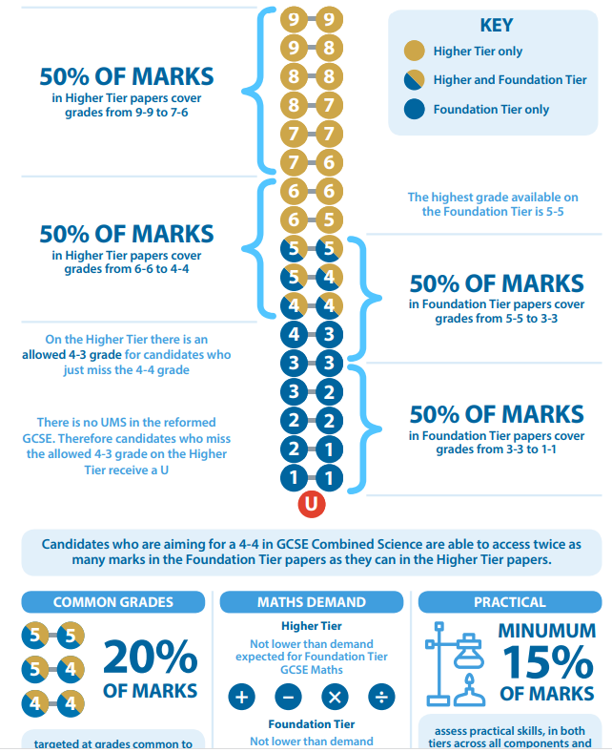
Combined
Science
Tiers & grading

