Slide 1
PRODUCT DESIGN
A LEVEL
COURSE BREAKDOWN:
UNIT 1: (EXAM) worth 50% final grade
UNIT 2: (NEA) worth 50% final grade

Slide 2
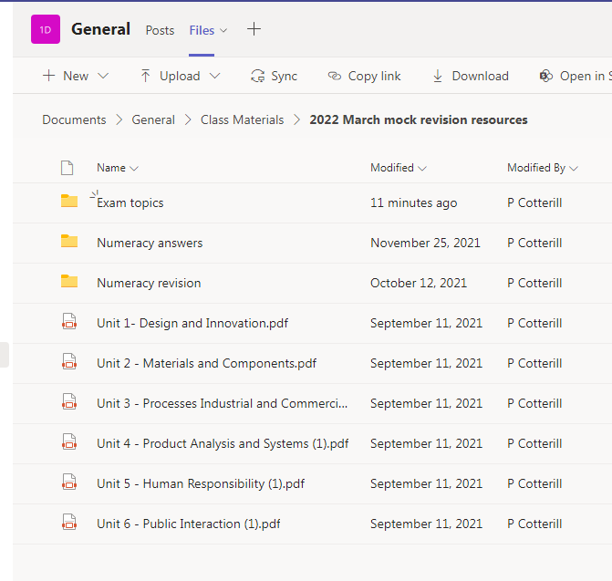
Top Tips and Quick wins ahead of March mock exam:
All revision resources are available on Teams using the following links:

Slide 3
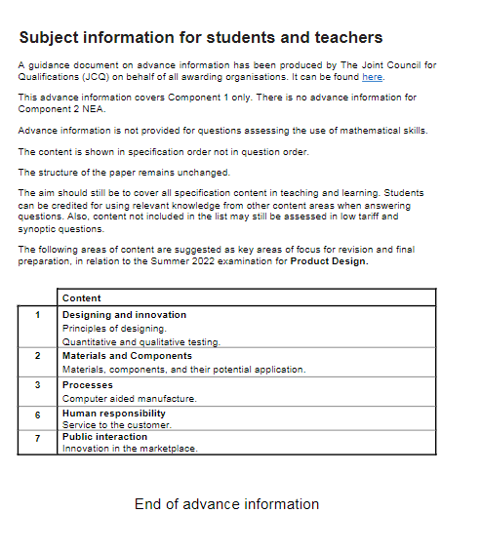
Advance Information provided by Eduqas exam board (available on TEAMS)
Summer Exam:
June 9th 2022
100 MARKS (no change)

Slide 4
ESSENTIAL REVISION TIPS BETWEEN NOW AND MARCH MOCKS:
You must fully revise Materials and Processes
(Units 2 & 3)
Any topics from these Units could be on your March mock and Summer exam!

Slide 5
MARCH MOCKS REVISION LIST:
Materials – Synthetic, Natural, Regenerated, Composites
Anodising metals
Critical Paths
Patents – Intellectual Property Protection
4 P's of the marketing mix
Methods and strategies used to promote products
Five stages of Risk Assessment
Product Life Cycle – stage by stage
Benefits and limitations of using wind power when manufacturing products
Morphological analysis and brain-storming in the design process
Product champions and Entrepreneurs influencing design innovation
(Highlighted in red are topics for the higher marks questions)

Slide 6
ESSENTIAL REVISION TIPS BETWEEN NOW AND MARCH MOCKS:
Must remember to practice and revise NUMERCACY based questions and formulas!
Percentages
Areas and Volumes
(Available on TEAMS)

Slide 7
HOW CAN YOU HELP TO SUPPORT WITH REVISION:
Test students on specific topics using the following revision techniques:
Flash cards
Mind-maps (use colours to group information)
Chunking topics into manageable amounts
Read, write, revise, check
Recall topics revised days and weeks ago
Highlight any information students fail to recall
Repeat, repeat, repeat
Monitor if students are following revision plans
Must avoid cognitive overload (cramming in last minute)

Slide 8
Structure your revision carefully, week by week!

