Slide 1
Maths

Slide 2
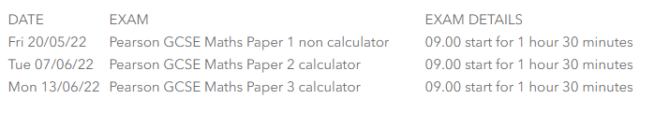
Exams
Higher Tier – 3 x 90 minute papers
P1 is a non calculator paper
P2 and P3 are calculator papers

Slide 3
Changes for 2022…
Formula sheet
“Content lists” for each paper
…still around 90% of content is on the list!
All will be posted onto Teams after the Spring mock exams

Slide 4
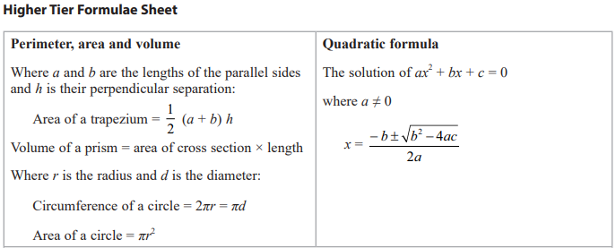

Slide 5
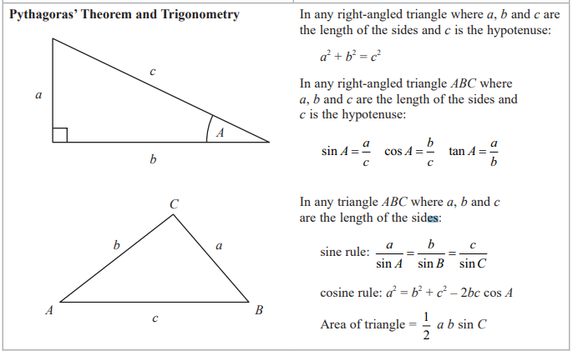

Slide 6
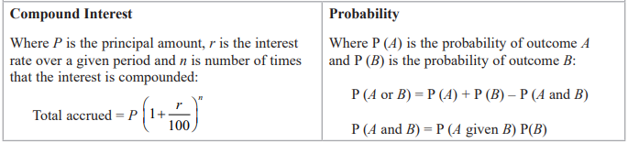
Alongside these formulae, you will be given specific other formulae to be used in a specific question, such as volume of a cone or sphere and the curved SA of a cone or sphere.

Slide 7
Step 1 | Step 2 | Step 3 | Step 4 | Step 5
Know your key formulae and facts | Learn each topic | Topic exam-style questions | Practice papers and mixing topics | Additional support
Look/cover/write/check or Flash cards | Revise and practise key topics on Hegarty Maths (or from a revision guide with practise questions) | Complete exam pack on that topic (see POD) to make sure you are 100% with the exam style | Practice lots of past papers so you can jump between topics, recognise key instructions and pick up marks! | Attend topic of the week sessions Tuesday Lunch and after school
At least 10mins every week – carefully check your answers – no mistakes! | Write your notes clearly with diagrams if they help. Try some questions… Show your working clearly. Check your answers and keep trying until you’ve cracked it! | Complete pack of exam questions for the topic… Check answers q by q – where can you pick up marks? Try more questions and check as you go. | IN CLASS: EVERY THURSDAY Try to complete as many of the questions as you can – try to pick up at least one mark on every question Use the time carefully – work by yourself and see what you can do yourself in the time Listen and watch the answers carefully Write your corrections in carefully and make sure you understand each line. | You will be given a “core skills” 5 quick questions on the topic of the week. Attempt the questions. The teacher will show you how to complete the skill. Write the full corrections out for each skill – these will be useful for further revision. Attempt some more questions from POD (see step 3) and in the after school session Keep your skills sharp with Key Skills sheets
 |  |  | AT HOME: EVERY WEEK Try to complete as many of the questions as you can – try to pick up at least one mark on every question Use your notes/revision guide to give you a prompt Get help with questions you don’t understand Check answers carefully – watch the video solutions/read through solutions on Teams when you need more than a quick fix. Write your corrections in carefully and make sure you understand each line. Hand in your effort each Friday and check any feedback

Slide 8
Maths revision
What do I need to know – recall of facts and rules - LCWC
Angle rules
Laws of indices
Circle theorems
Similarity rules
Frequency density
Compound measure formulae
Sets in a Venn diagram from set notation

Slide 9
Maths revision
What do I need to be able to do – core skills for each topic
Solve simultaneous equations
Calculate an interior angle in a regular polygon
Add/subtract algebraic fractions
Calculate a formula from direct or inverse proportion

Slide 10
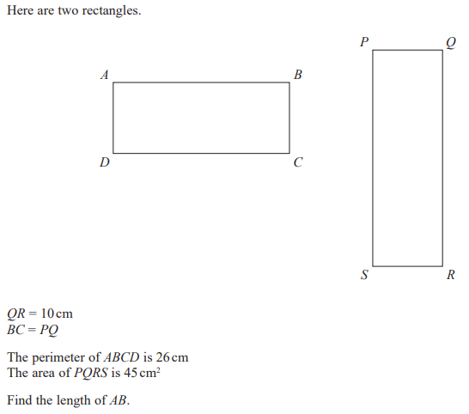
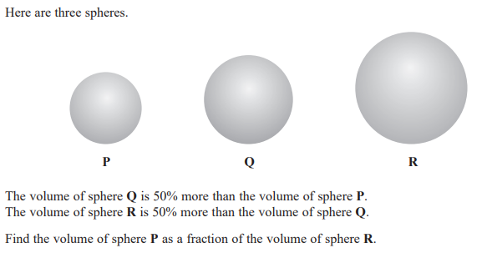
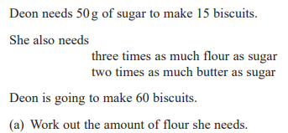
Maths revision
WHEN do I need to use each skill – application to exam questions

Slide 11
Lessons
Key skills sheets: targeted for each skills set and by paper
Exam style practise in lessons: previous exam questions to build familiarity and exposure
Exam papers with full solutions
Outside of lessons
Revision sessions on Tuesday after school
Revision task Tuesday form time
Exam packs (ready for after the mocks) with worked solutions will be uploaded to POD and Teams
HM and video tutorials online

Slide 12
Useful links
https://qualifications.pearson.com/content/dam/pdf/GCSE/mathematics/2015/teaching-and-learning-materials/W73038_GCSE_Mathematics_1MA1_AN_Accessible_version_V2.pdf
Advance information for GCSE content list
Practice papers (although these will include content we know is not on the exam)
https://www.mathsgenie.co.uk/papers.html
Topic Packs
https://www.mathsgenie.co.uk/gcse.html
Keep checking your Teams page and POD for the Topic packs that we are creating that are SPECIFICALLY for content we know is on the exam!

