Slide 1
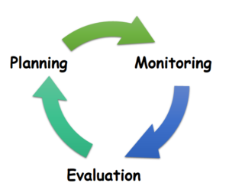
What makes an effective revision session?
A-Level Geography

Slide 2
What do you know (subject knowledge audit)
What do you need to know and what strategy will you use? (objective for the session)

Slide 3
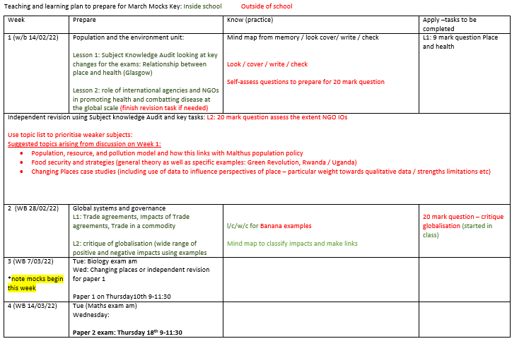

Slide 4
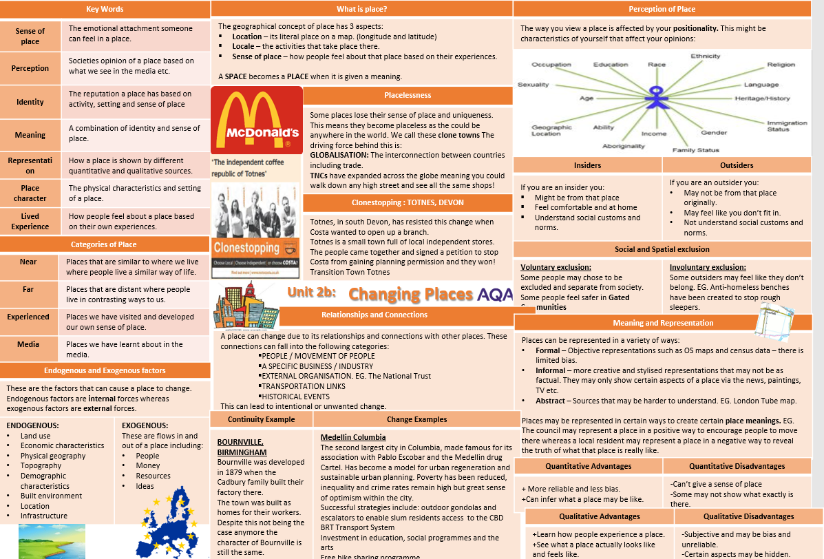
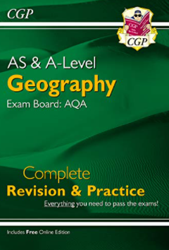
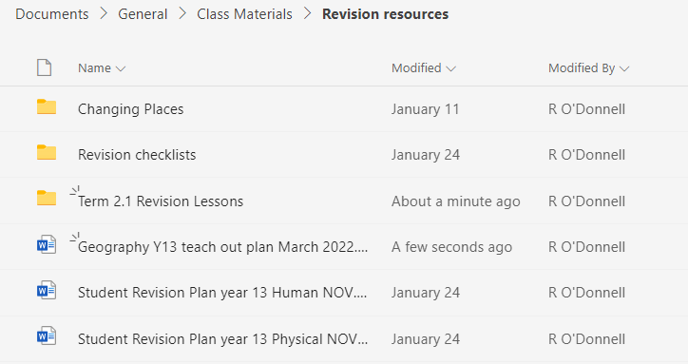
Sources of information

Slide 5
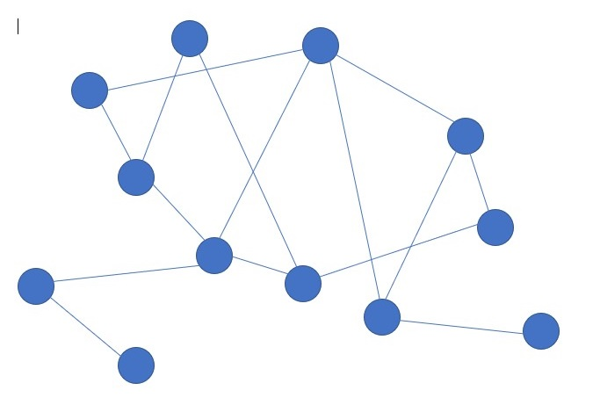
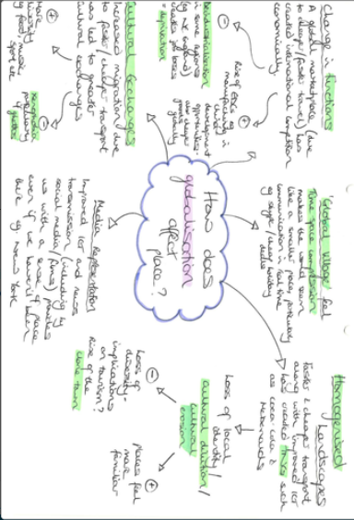
Revision strategy 1
Mind Map
Top tips
Check that your revision strategy has worked (remember the forgetting curve-allow time for this)

Slide 6
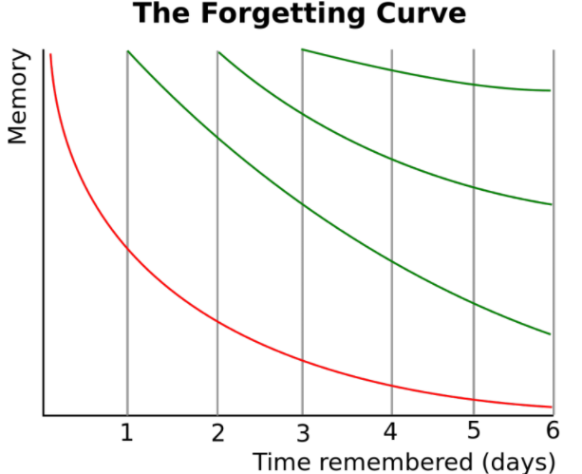
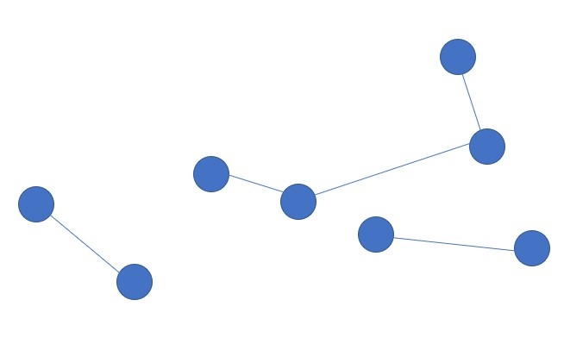

Slide 7
2. Monitoring of that strategy (how will you test yourself to see if it is working?)
Create questions that you can use to test your future self (no answers necessary )
Ask someone to help you by quizzing you on your mind map
Recreate your mind map from memory, going back to your notes and including any missed information in a different colour

Slide 8
3. Consolidation time (5 minute evaluation – did it work, do I need to go over something again, what will I revise next time?)

Slide 9
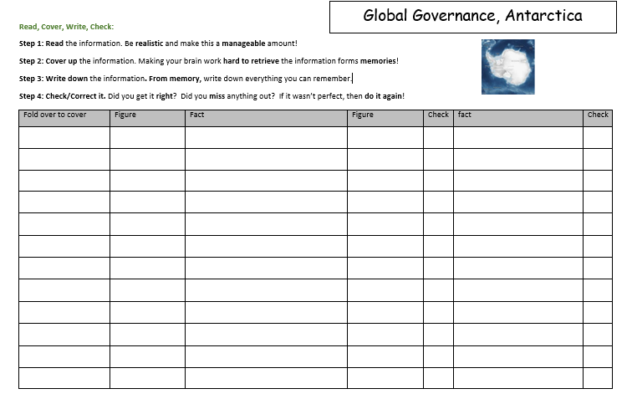
Revision strategy 2
Look / Cover / Write / Check

Slide 10
Quick wins ahead of the mocks

Slide 11
What can parents do to support?
What do you know (subject knowledge audit)
What do you need to know and what strategy will you use (objective for the session)
Monitoring of that strategy (how will you test yourself to see if it is working?)
Consolidation time (5 minute evaluation – did it work, do I need to go over something again, what will I revise next time?)

