Slide 1
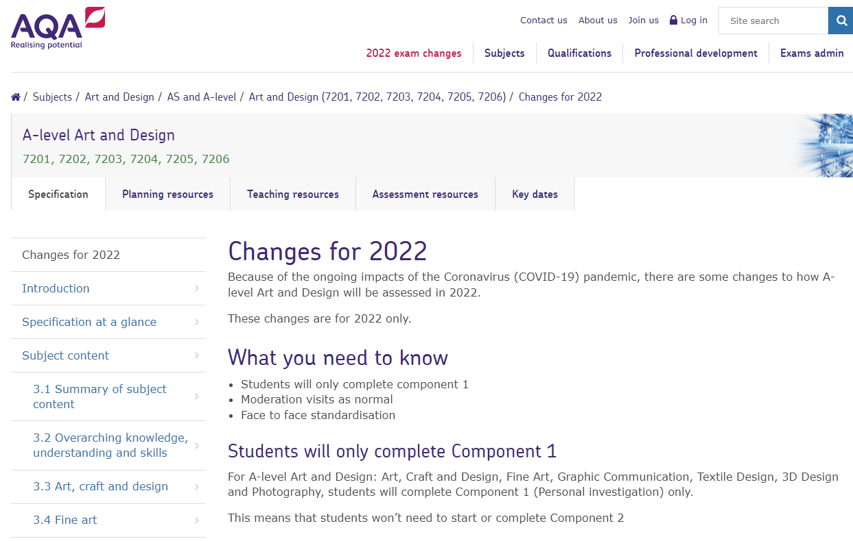
https://www.aqa.org.uk/subjects/art-and-design/as-and-a-level/art-and-design-7201/changes-for-2022

Slide 2
Component 1: Personal investigation
This is a practical investigation supported by written material.
Students are required to conduct a practical investigation, into an idea, issue, concept or theme, supported by written material. The focus of the investigation must be identified independently by the student and must lead to a finished outcome or a series of related finished outcomes.
The investigation should be a coherent, in-depth study that demonstrates the student’s ability to construct and develop a sustained line of reasoning from an initial starting point to a final realisation.
The investigation must show clear development from initial intentions to the final outcome or outcomes. It must include evidence of the student’s ability to research and develop ideas and relate their work in meaningful ways to relevant critical/contextual materials.
The investigation must be informed by an aspect of contemporary or past practice of artists, photographers, designers or craftspeople.
The written material must confirm understanding of creative decisions, providing evidence of all four assessment objectives by:
clarifying the focus of the investigation
demonstrating critical understanding of contextual and other sources
substantiating decisions leading to the development and refinement of ideas
recording ideas, observations and insights relevant to intentions by reflecting critically on practical work
making meaningful connections between, visual, written and other elements.

Slide 3
The Essay
The written material must: be a coherent and logically structured extended response of between 1000 and 3000 words of continuous prose.
include specialist vocabulary appropriate to the subject matter
include a bibliography that, identifies contextual references from sources such as: books, journals, websites, through studies of others’ work made during a residency, or on a site, museum or gallery visit
be legible with accurate use of spelling, punctuation and grammar so that meaning is clear.
Students can present the written material as a single passage of continuous prose or as a series of shorter discrete, but linked, passages of continuous prose incorporated within the practical work.
There is no restriction on the scale of practical work produced. Students should carefully select, organise and present their work for their Personal investigation to ensure it is well structured and provides evidence that meets the requirements of all four assessment objectives.
The personal investigation will be assessed as a whole. Evidence of meeting the requirements of all four assessment objectives must be provided in both the practical and written material.

Slide 5
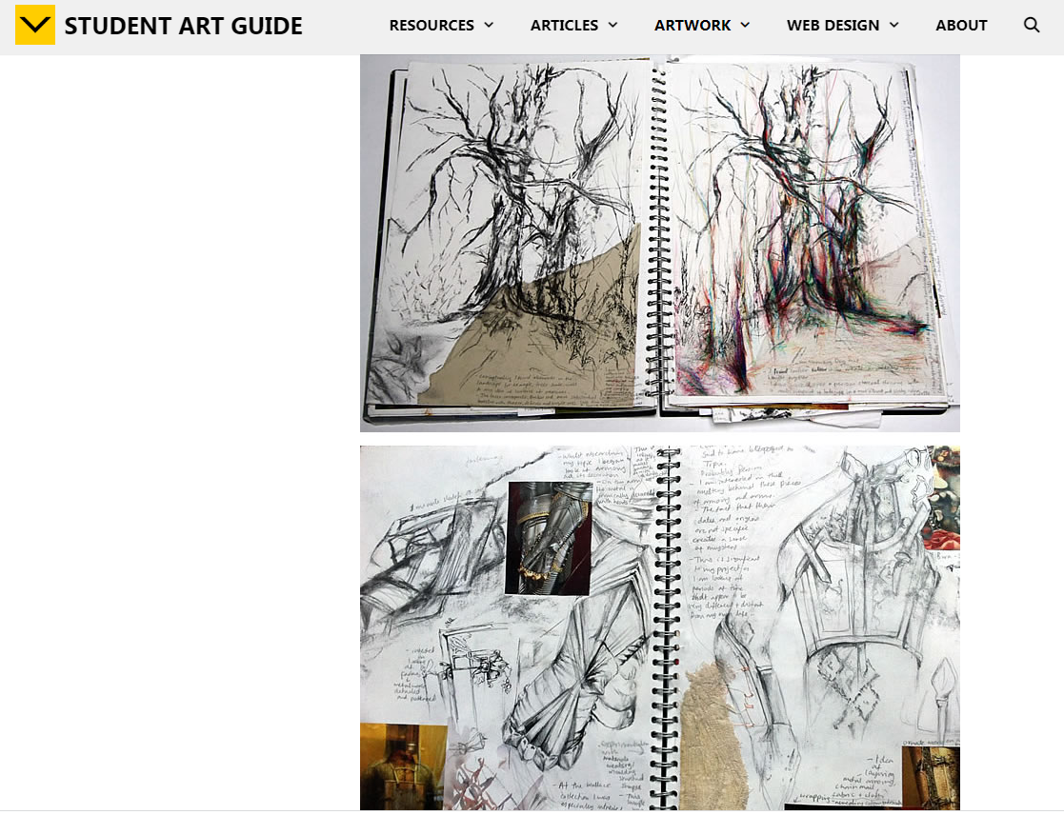
https://www.studentartguide.com/

Slide 6
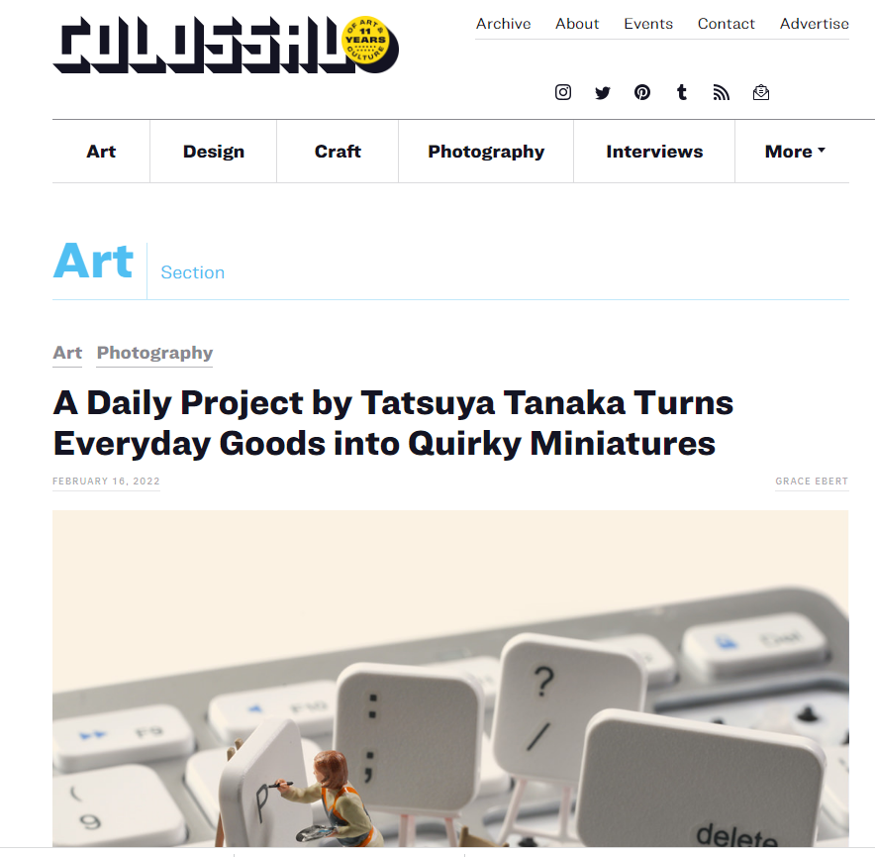
https://www.thisiscolossal.com/category/art/

Slide 7
Deadlines
Essay due in Friday 8th April
Final date for completion Friday 20th May and submission of all sketchbooks/ folders from the beginning of the course

Slide 8
3.8 Photography
Students should be introduced to a variety of experiences that explore a range of photographic media, techniques and processes. They should be made aware of both traditional and new technologies.
Students should explore relevant images, artefacts and resources relating to a range of art, craft and design, from the past and from recent times, including European and non-European examples.
This should be integral to the investigating and making processes. Students' responses to these examples must be shown through practical and critical activities that demonstrate their understanding of different styles, genres and traditions.
Students should use sketchbooks/workbooks/journals to underpin their work where appropriate. They may wish to develop their drawing skills in order to produce storyboards, thumbnail sketches and/or diagrams, where appropriate.
Students may use traditional methods and/or digital techniques to produce images.
Students should be aware of the four assessment objectives to be demonstrated in the context of the content and skills presented and of the importance of process as well as product.

Slide 9
Examiners Report
In photography, the most successful students demonstrated their knowledge and understanding of manual settings by recording aperture, ISO and exposure.
Contact-sheets provided a record of multiple photoshoots and documented selection. Evidence of how and why images were manipulated was provided in successful work. In some examples, contact sheets were printed too small or not printed clearly.
Where students did not include contact sheets, they were unable to successfully demonstrate the process of selecting images.

Slide 10
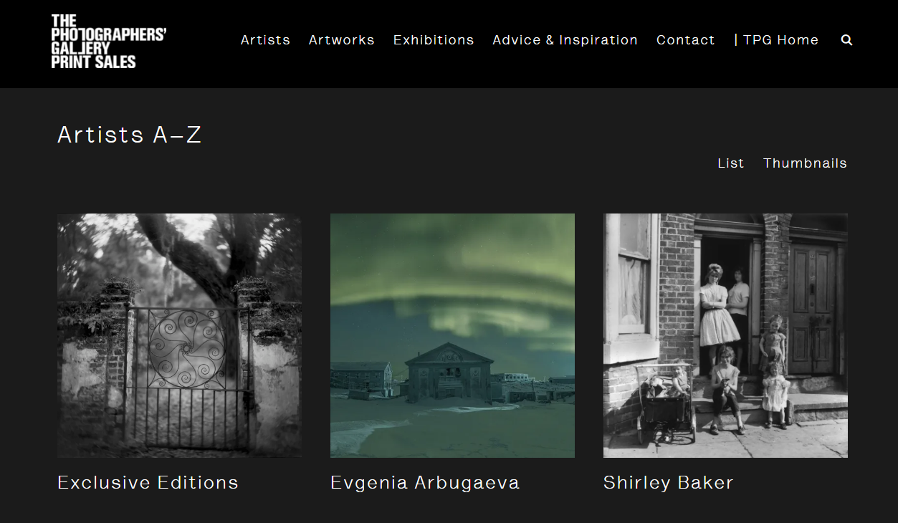
https://printsales.thephotographersgallery.org.uk/artists/

Slide 11
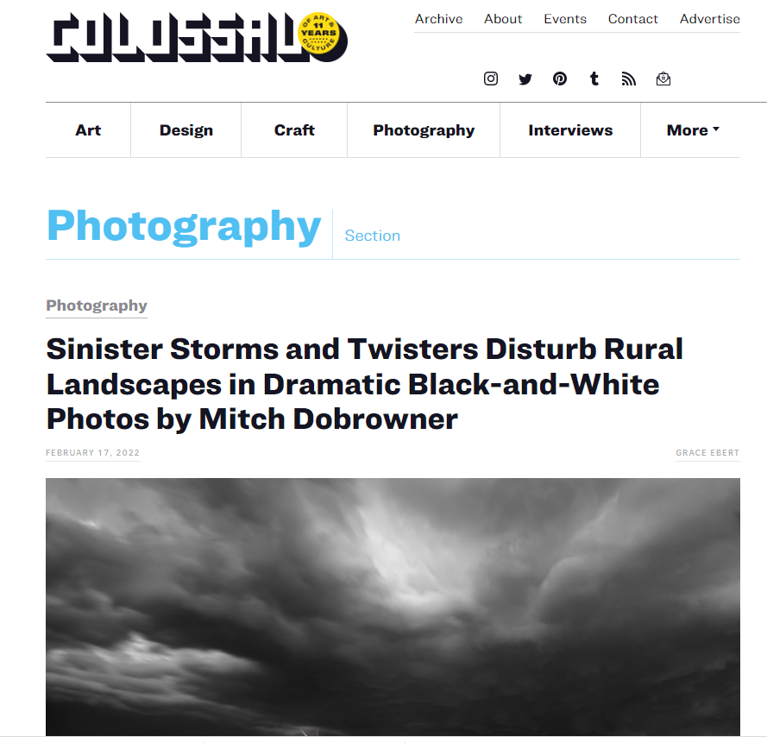
https://www.thisiscolossal.com/category/photography/

Slide 12
Deadlines
Essay due in Friday 8th April
Final date for completion Friday 20th May and submission of all sketchbooks/ folders from the beginning of the course

