Slide 1
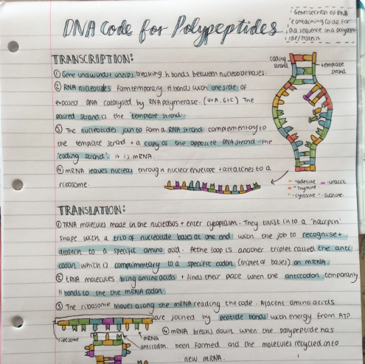
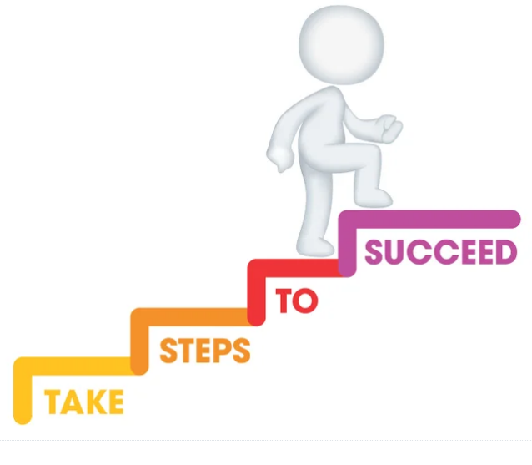
How to revise for A Level Biology

Slide 2
What do we need to do?
How will we do it?
Know
Master
Apply
Interleve

Slide 3
In class we review information and key vocabulary ensuring that students have a concrete basis before applying their knowledge.
Linking together concrete examples to form an overarching knowledge of the specification.
Confidence in knowledge and understanding.
Students must explain science using specific scientific vocabulary.

Slide 4
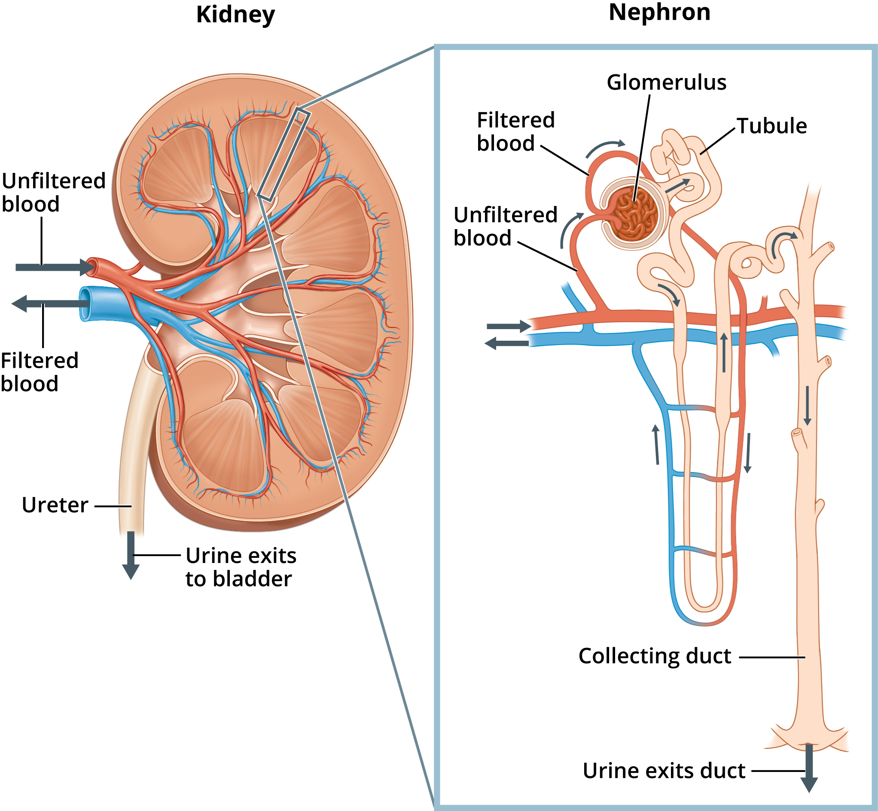
Discussion, questions, talk others through it, work together. Find out where your gaps are and do something about it there and then.
Students must explain content with many levels of detail.

Slide 5
Knowledge recall…
Write everything you know about…
Blank sheets of paper can be scary but can be a great learning opportunity.
Students must explain content with many levels of detail.

Slide 6
Review, break, revisit, break…
The more we do this cycle the greater our knowledge is committed to our long term memory.
This means that it is ‘known’ content and therefore more comfortably applied to both known and unknown contexts.
Students must apply knowledge to both known and unknown contexts.

Slide 7
Active note taking involves turning the material into a different format…
Simply copying notes is passive and limited in impact.
Students must process information to ensure active learning.

Slide 8
Switching between ideas and areas of content is essential to succeeding in A Level Biology papers.
The best way to develop this is through completion of past paper questions.
Students must apply knowledge to exam style questions.

Slide 9
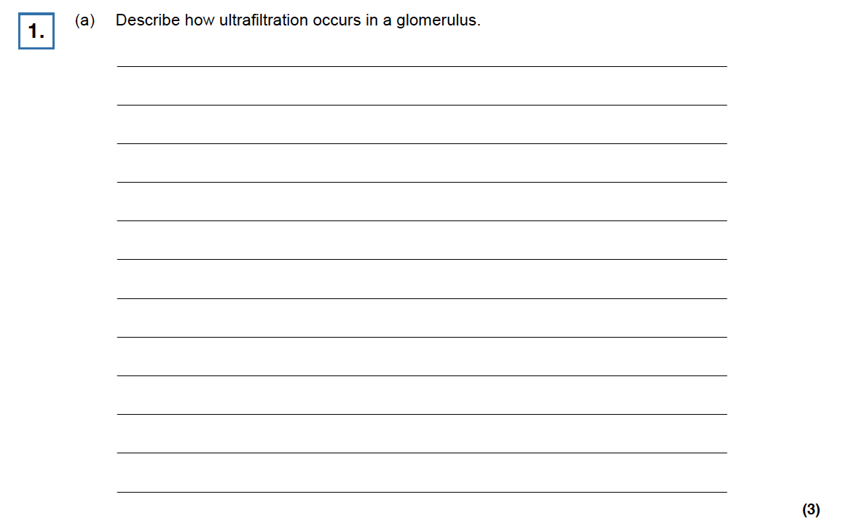

Slide 10
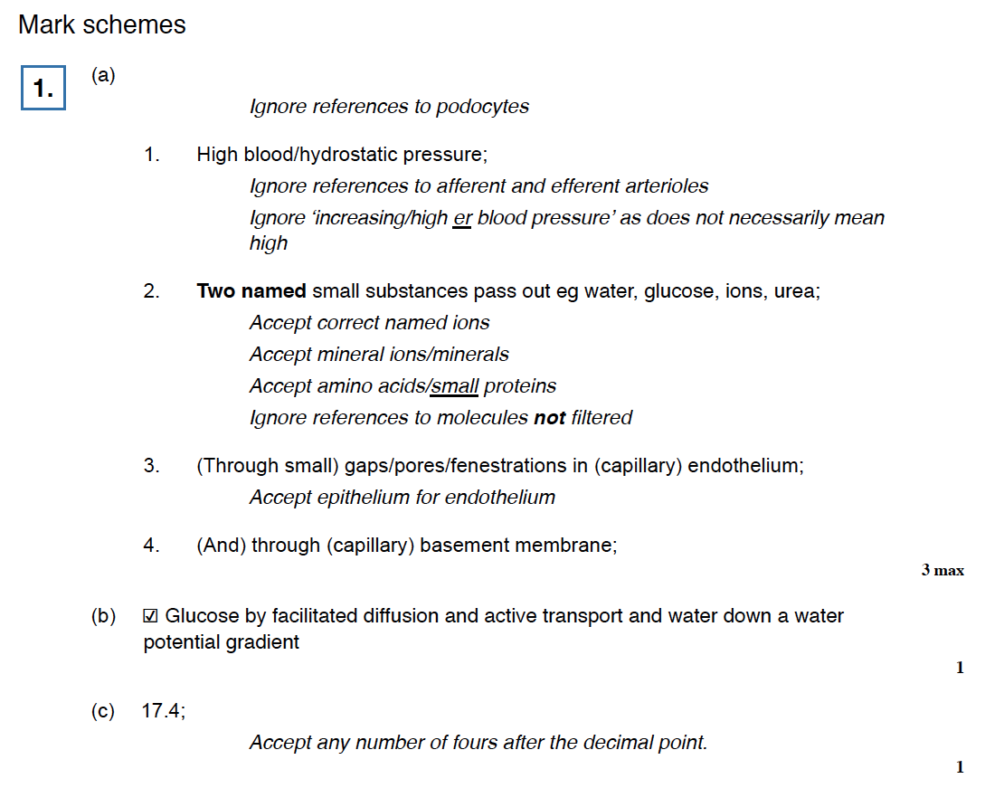

Slide 11
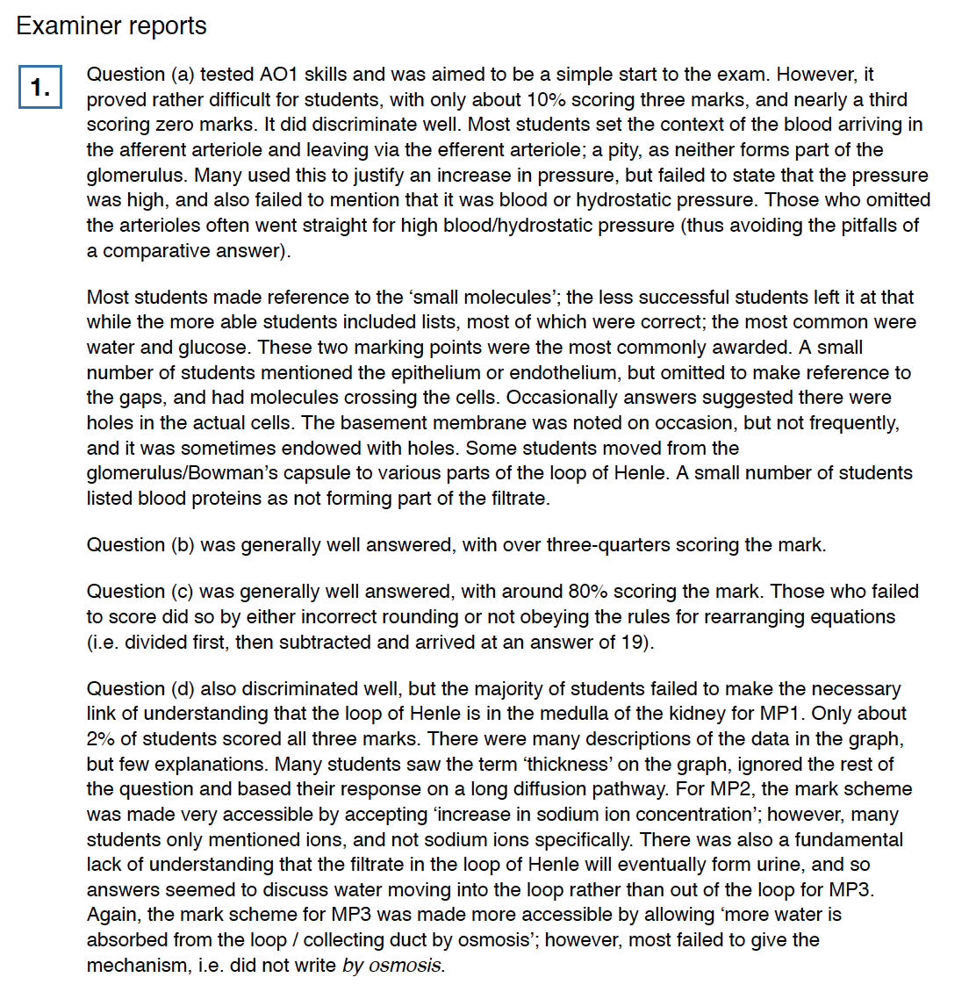

Slide 12
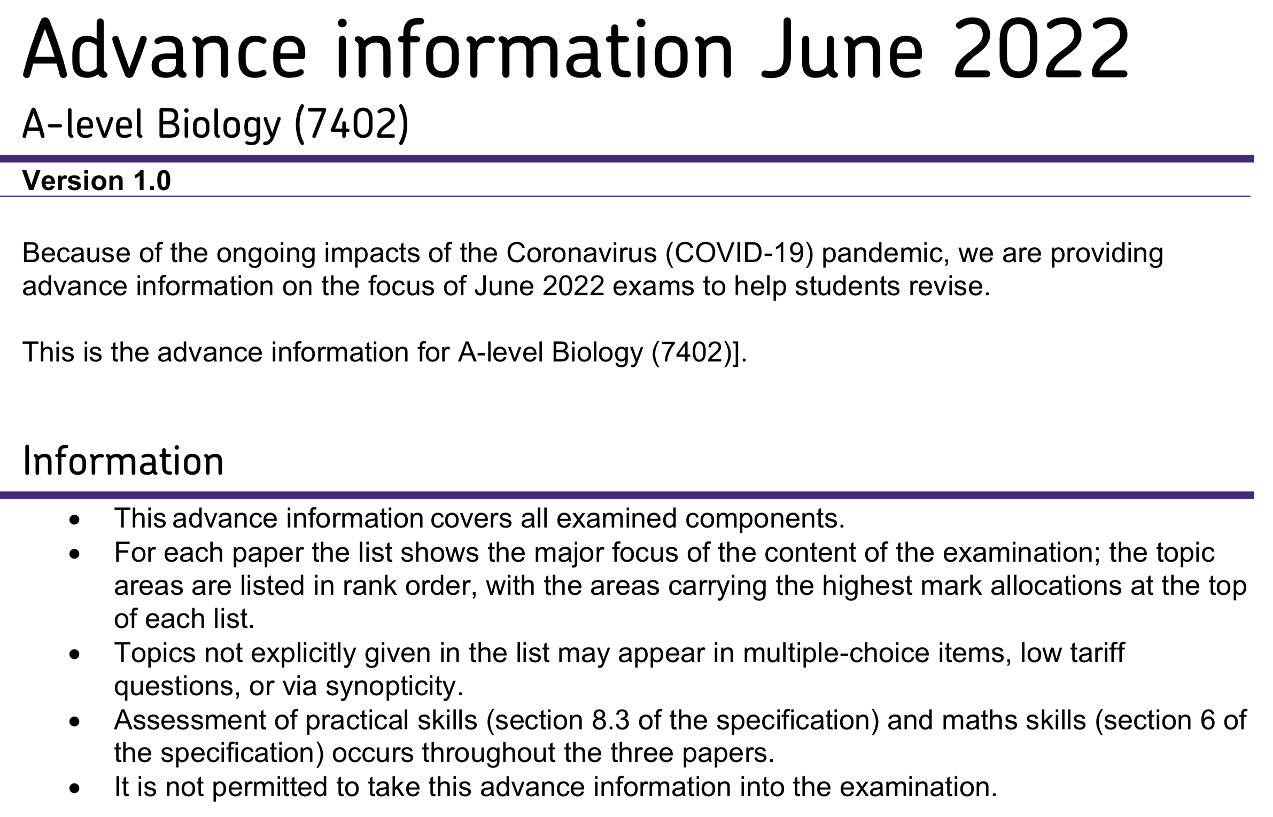

Slide 13
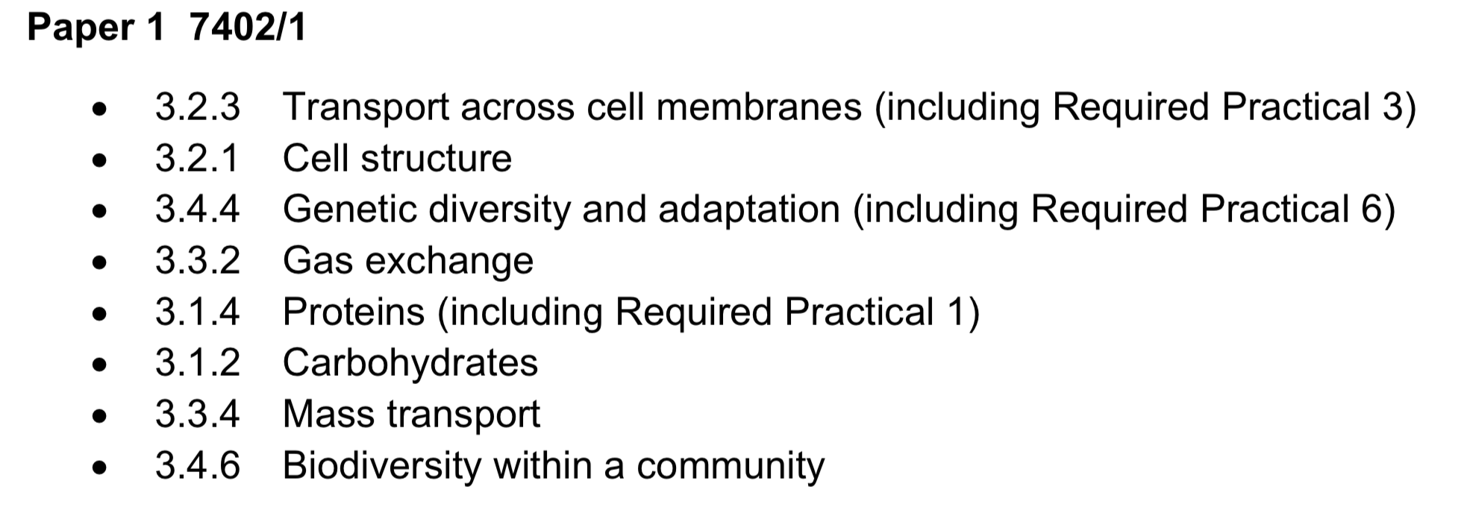
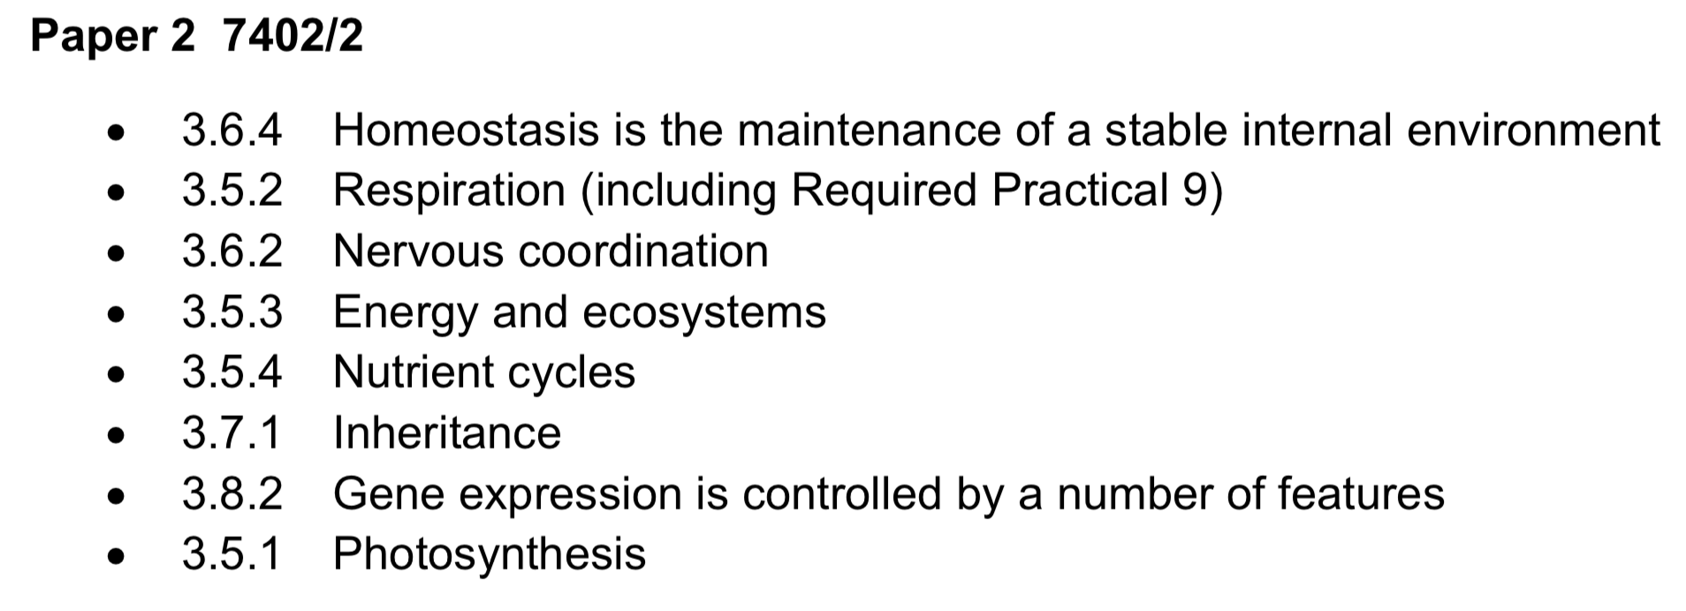
Pre-release information
https://filestore.aqa.org.uk/content/summer-2022/AQA-7402-AI-22.PDF

Slide 14
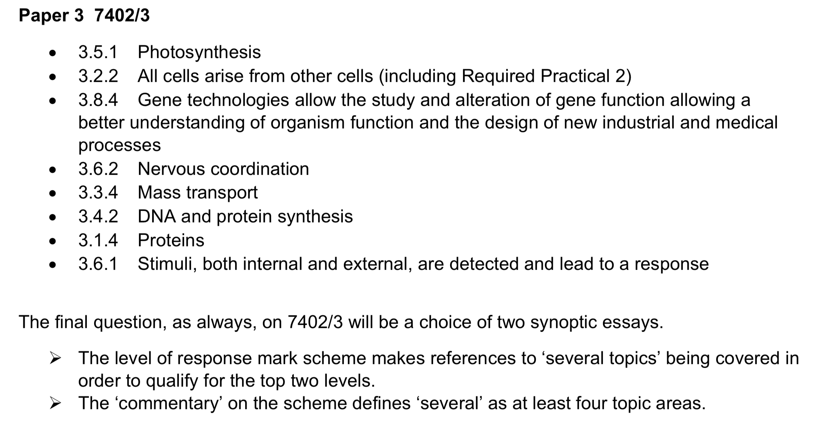
Pre-release information
https://filestore.aqa.org.uk/content/summer-2022/AQA-7402-AI-22.PDF

Slide 15
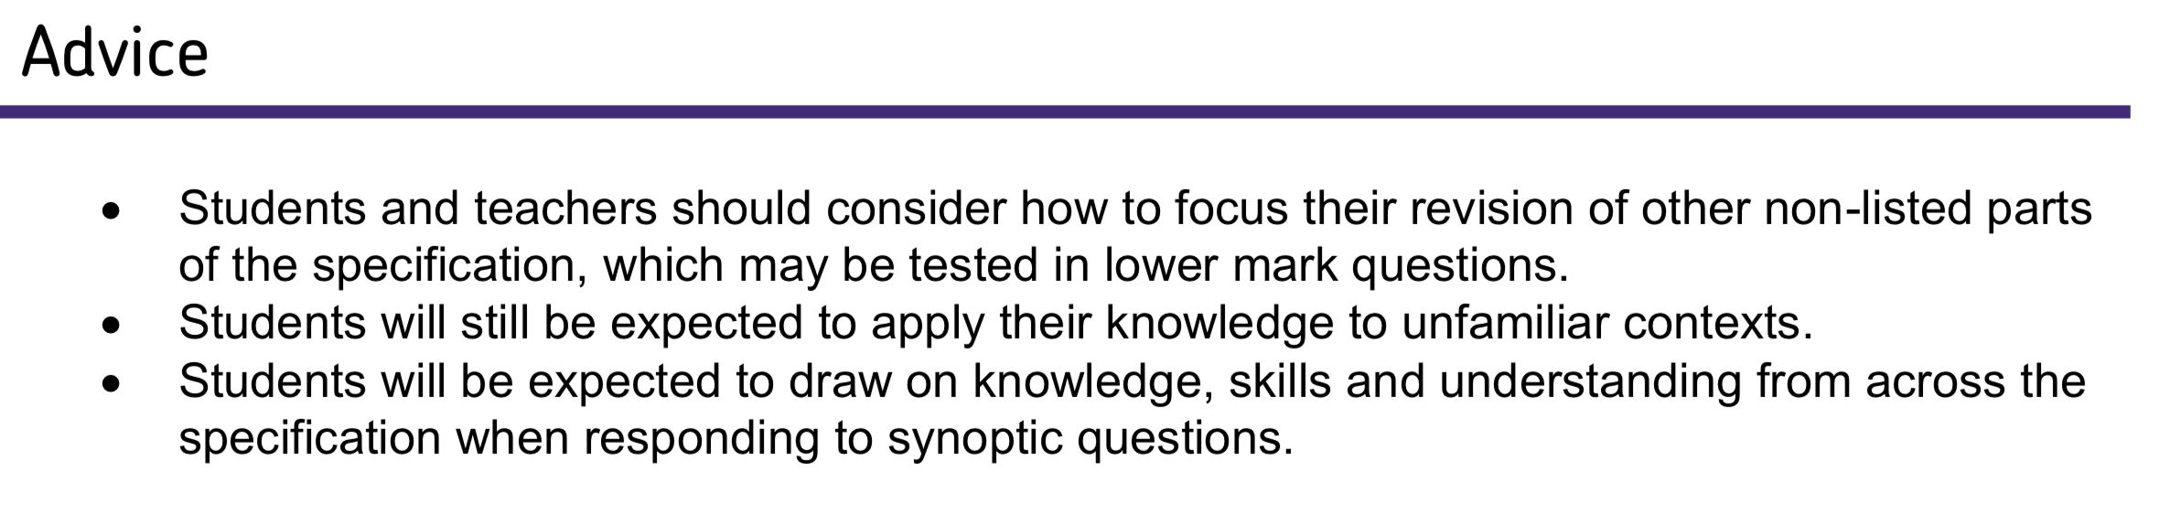
Health warning

Slide 16
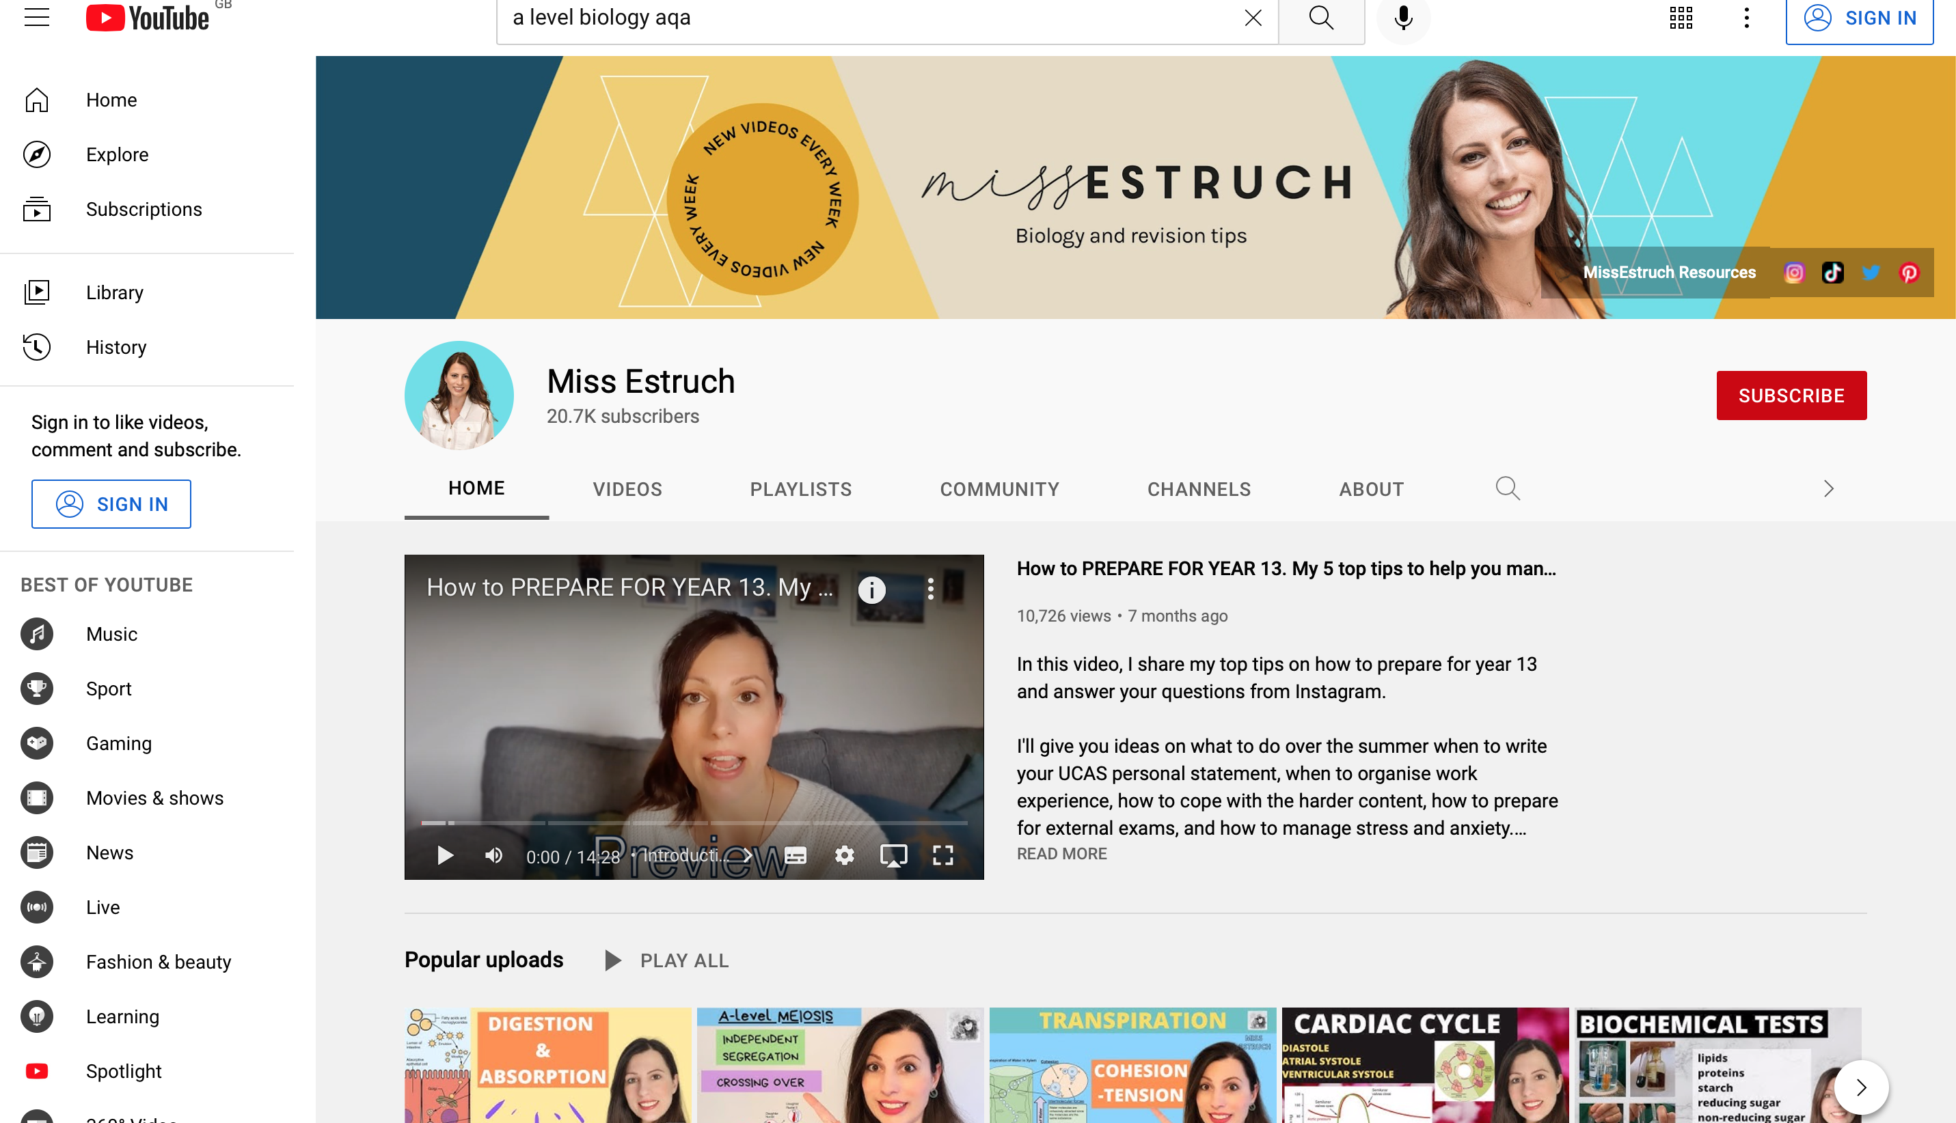
Useful Biology Websites…
YouTube https://www.youtube.com/results?search_query=a+level+biology+aqa

Slide 17
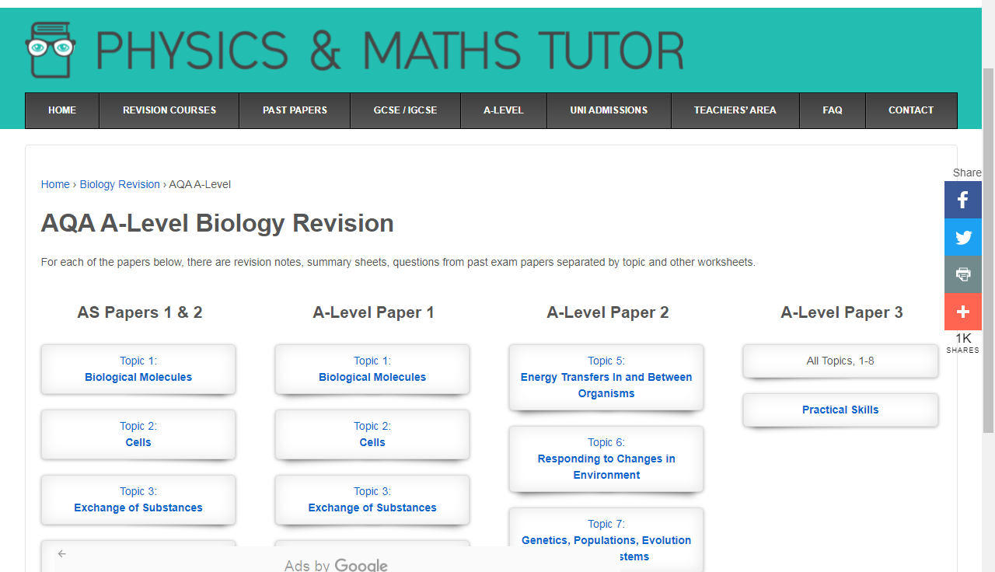
Useful Biology Websites…
Physics and Maths Tutor: https://www.physicsandmathstutor.com/

Slide 18
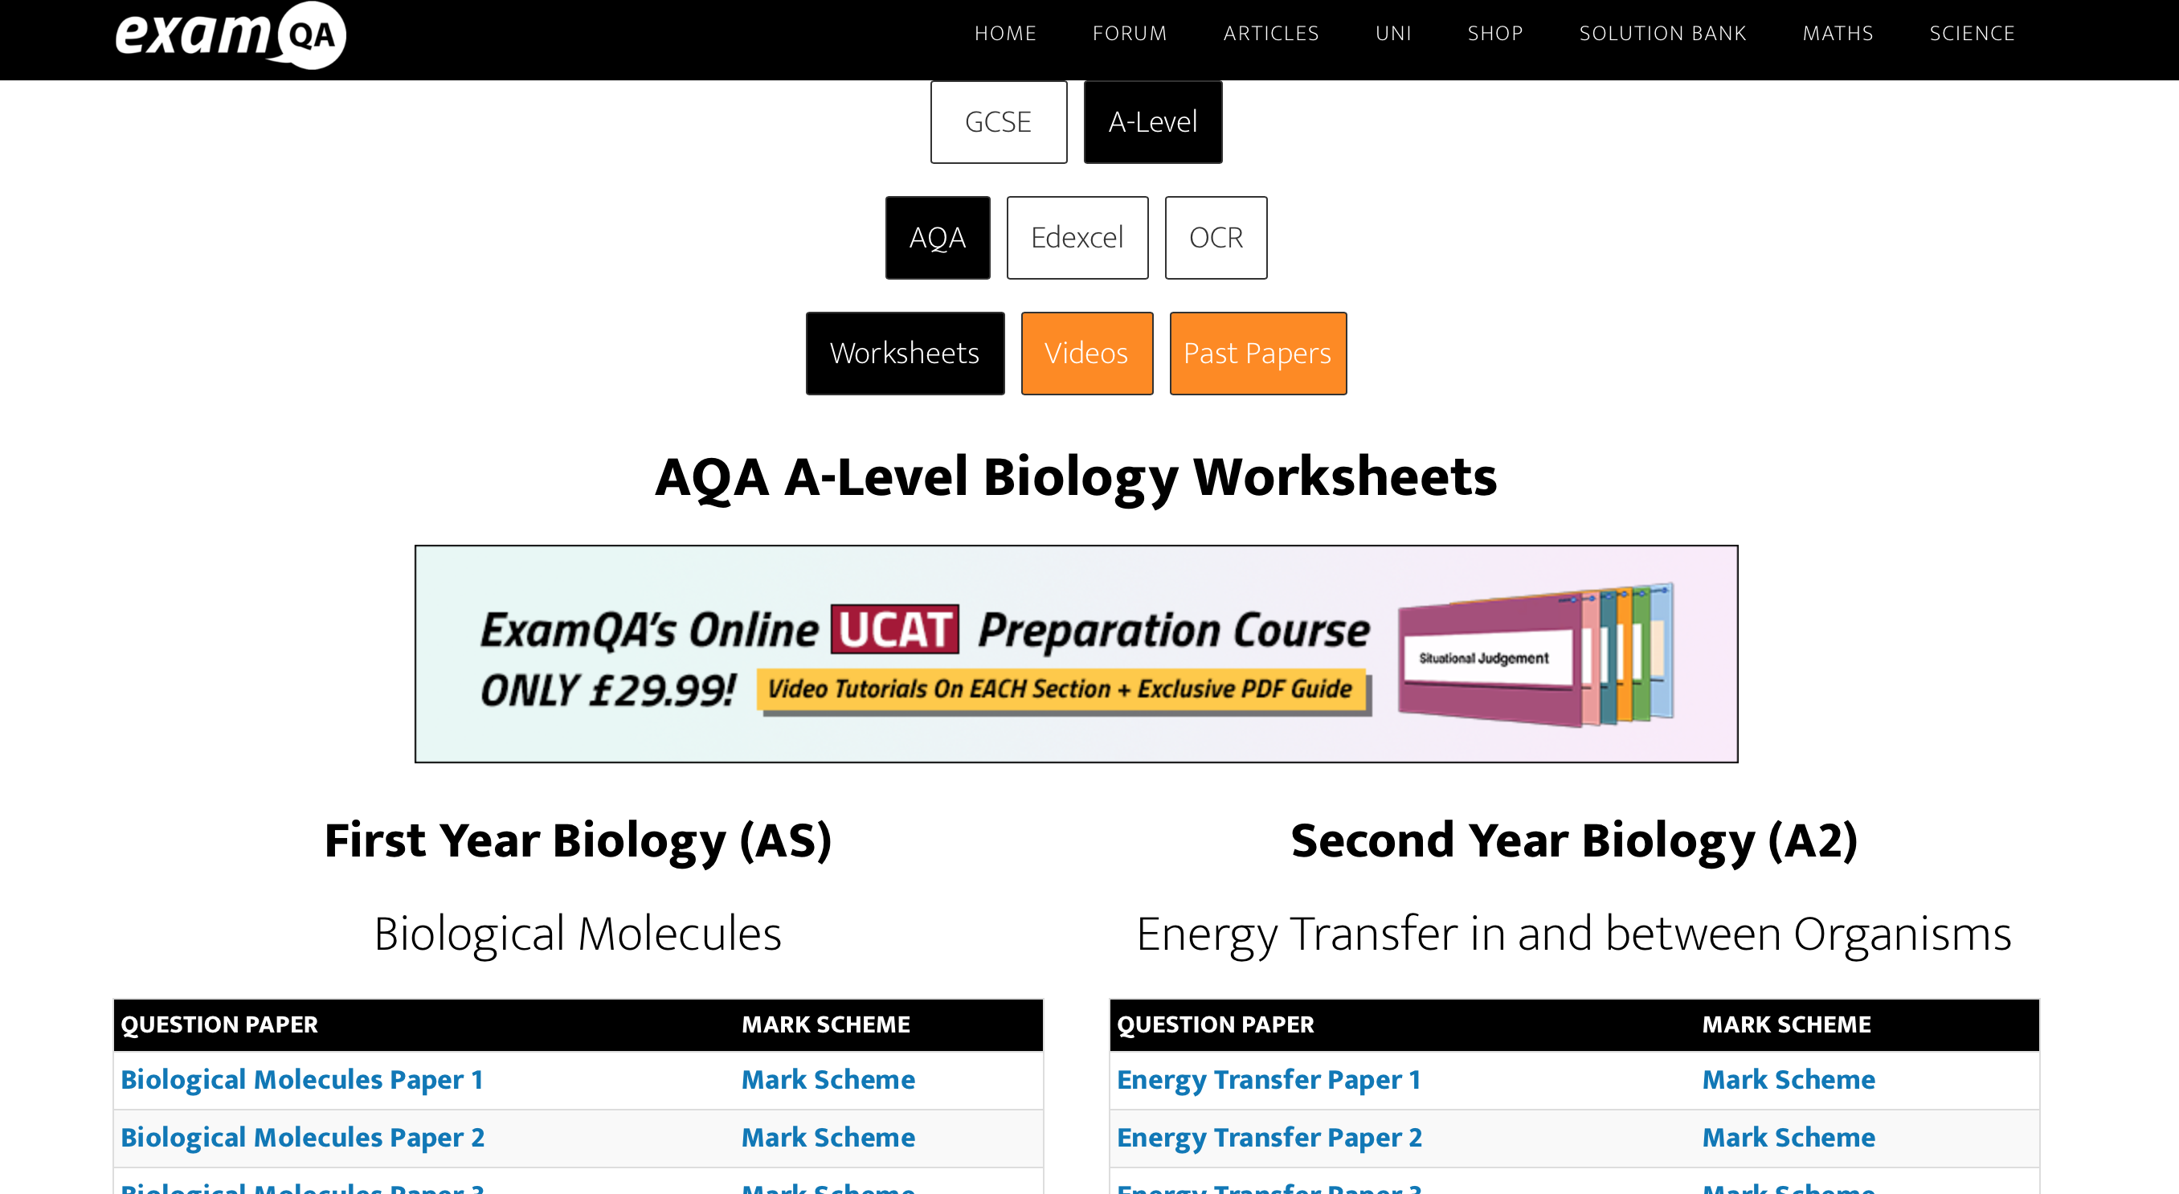
Useful Biology Websites…
ExamQA: https://examqa.com/alevel/biology/

Slide 19
The key points
Revision needs to involve active strategies (not just reading!)
Use spaced retrieval and interleaving so that you have to decipher the question content before you begin.
Find full papers on the AQA website:
https://www.aqa.org.uk/subjects/science/as-and-a-level/biology-7401-7402/assessment-resources

Slide 20
The key points
Do as many past paper questions as you possibly can (there are only so many ways that they can re-word a question!)
Avoid specimen papers as the questions are not as high quality.
On completion of exam questions, use both the mark scheme and the examiners’ commentary to gain insights into key difficulties that students faced.

Slide 21
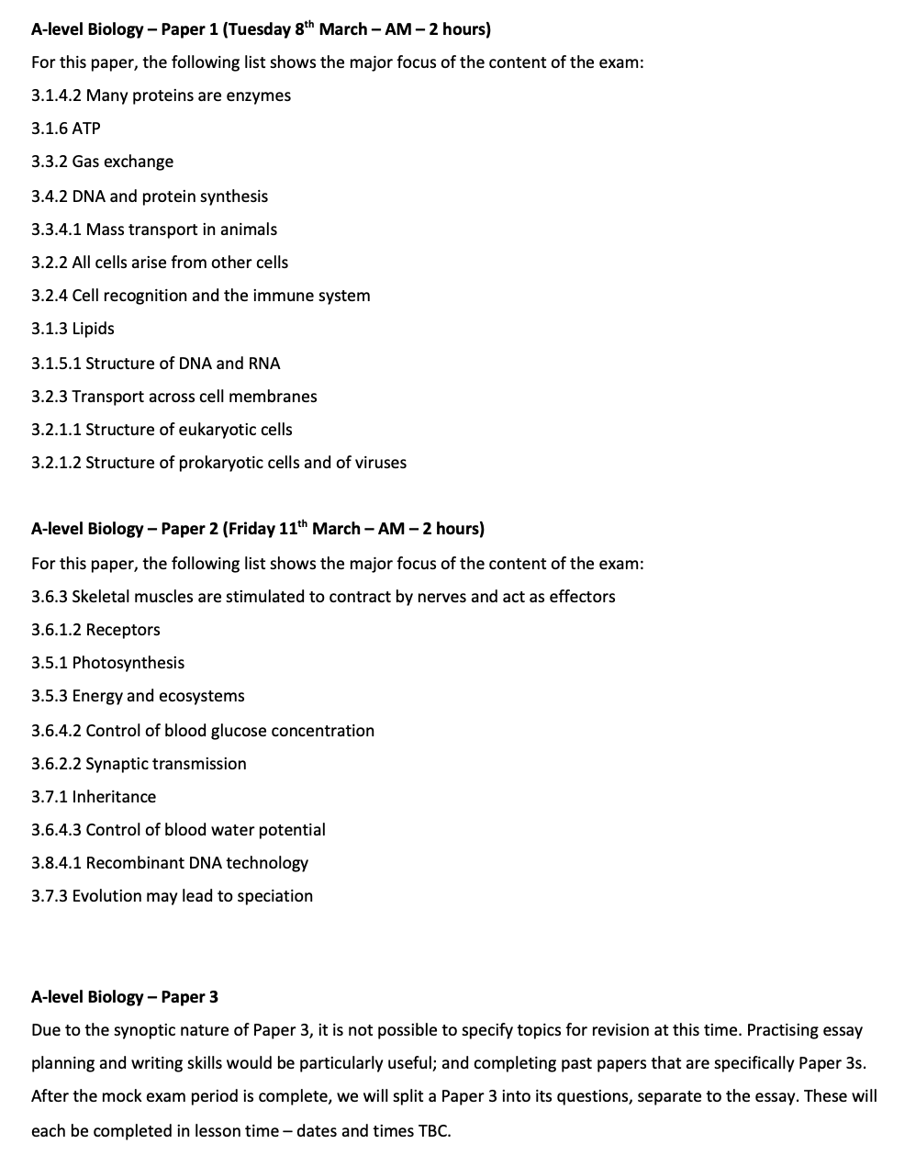
What’s next?
Mock exams
Paper 1 – 8th March
Paper 2 – 11th March
Paper 3 – in class following the mock exam window

