Slide 1
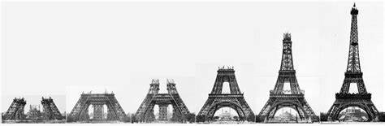
Adjustments and Revision for
French and Spanish

Slide 2
GCSE French / Spanish Themes
Theme 1: Identity and culture
Me, my family and friends
Technology in everyday life
Free-time activities
Customs and festivals
Theme 2: Local, national, international and global areas of interest
Home, town, neighbourhood and region
Social issues
Global issues
Travel and tourism
Theme 3: Current and future study and employment
My studies
Life at school/college
Education post-16
Jobs, career choices and ambitions
Listening 25%
Speaking 25%
Reading 25%

Slide 3

GCSE Spanish Adjustments
Theme 1: Identity and culture
Me, my family and friends
Technology in everyday life
Free-time activities – not in the 90 word questions
Customs and festivals
Theme 2: Local, national, international and global areas of interest
Home, town, neighbourhood and region
Social issues
Global issues
Travel and tourism
Theme 3: Current and future study and employment
My studies
Life at school/college
Education post-16 – not in the 150 word questions
Jobs, career choices and ambitions
Writing 25%

Slide 4

GCSE French Adjustments
Theme 1: Identity and culture
Me, my family and friends
Technology in everyday life
Free-time activities
Customs and festivals- not in the 90 or 150 word questions
Theme 2: Local, national, international and global areas of interest
Home, town, neighbourhood and region
Social issues
Global issues– not in the 90 word questions
Travel and tourism- not in the 90 or 150 word questions
Theme 3: Current and future study and employment
My studies
Life at school/college
Education post-16 – not in the 90 word questions
Jobs, career choices and ambitions
Writing 25%

Slide 5
learn vocabulary
revise basic tense structures
learn vocabulary
speak out loud
learn vocabulary
listen to the language
learn vocabulary
The Basics

Slide 6
AQA vocabulary list
Purple Revision Workbook
Speaking test questions
booklet / flashcards
The Basics

Slide 7


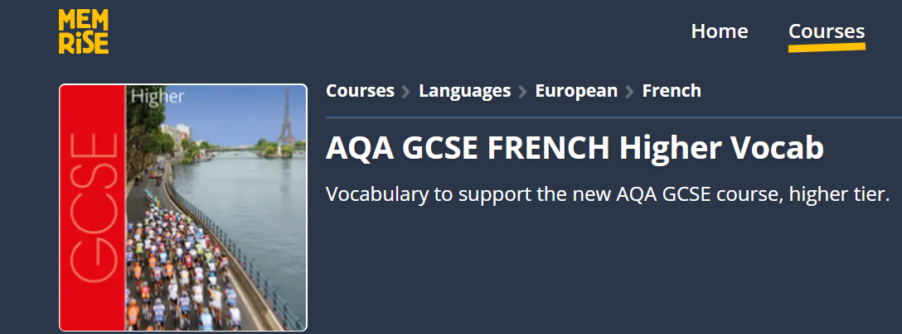
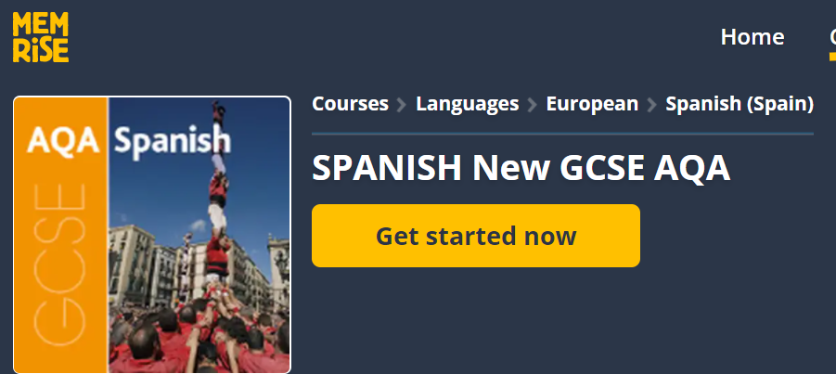

Slide 8

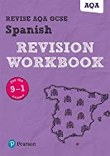

Slide 9
learn groups of words from the same topic area
copy / cover / write
look for related words / families of words
make silly connections
highlight the vocab you know – go back to the unhighlighted words
get someone to test you
Memrise little and often – 10 mins a day
How do I learn vocabulary?

Slide 10
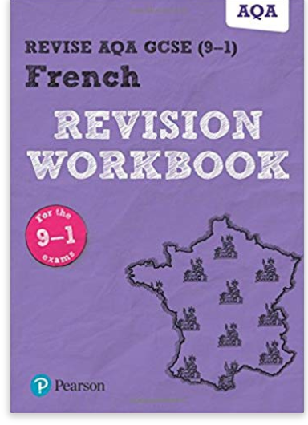
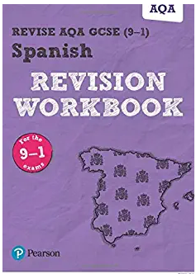



Listening
Use the revision guide
Listen to the language
Listen online to French or Spanish

Slide 11
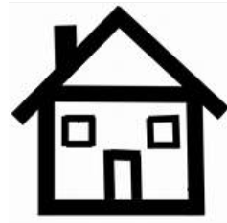

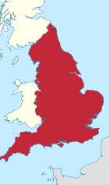

Speaking
make flashcards – question on the front / answer on the back
on the front add some silly pictures to help you remember the info on the back
¿Dónde vives?
BC
Vivo en una casa grande en las afueras del pueblo que se llama Barnard Castle. Está en el noreste de Inglaterra cerca de Darlington.
D D

Slide 12

Speaking
make flashcards – question on the front / answer on the back
cover up some of the card with coins or items from your pencil case
¿Dónde vives?
Vivo en una casa grande en las afueras del pueblo que se llama Barnard Castle. Está en el noreste de Inglaterra cerca de Darlington.

Slide 13
Speaking
make flashcards – question on the front / answer on the back
write it on a mini white board, erase some words and try to say it out loud
____ en una casa _____en las afueras del pueblo ___se llama Barnard Castle. ____ en el noreste de _________ cerca de Darlington.
¿Dónde vives?

Slide 14
Speaking
make flashcards – question on the front / answer on the back
write it on a mini white board, erase some words and try to say it out loud
____ en una _____ _____en las afueras del pueblo ___se _____ Barnard Castle. ____ en el ________ de _________ cerca de _________.
¿Dónde vives?

Slide 15

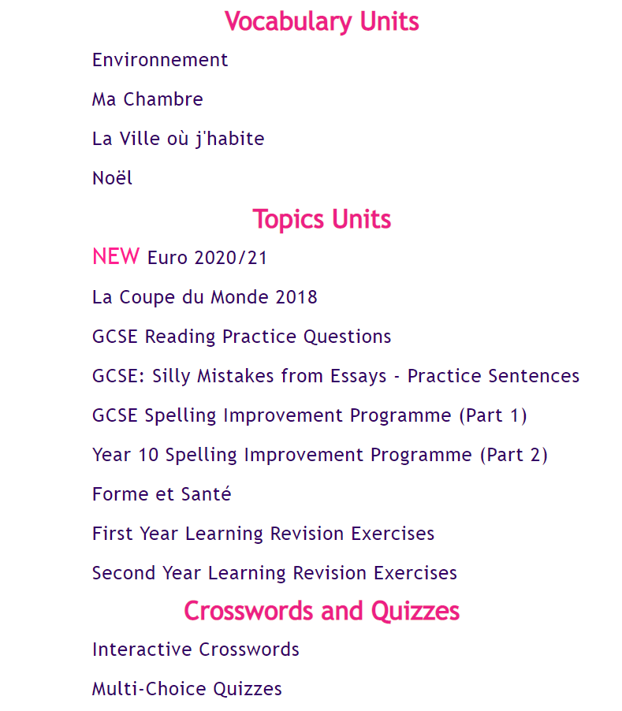

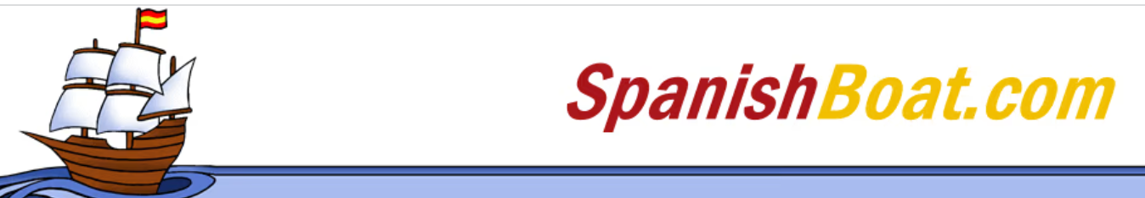
Reading
Use the revision guide
Read articles online

Slide 16
Writing
collect and learn a selection of key phrases in a range of tenses and make sure you work them into your piece – plan around them
90 word piece
Past Tense
je suis allé
j’ai joué / j’ai mangé
on s’est bien amusés
c’était
Future tense
je voudrais aller
je vais étudier
ce sera
Opinions
ce que j’aime le plus c’est
selon mon ami c’est
quel dommage
Complex phrases
bien qu’il soit…
j’en ai marre

Slide 17
Writing
collect and learn a selection of key phrases in a range of tenses and make sure you work them into your piece – plan around them
150 word piece
cuando sea mayor
si tuviera más dinero
nunca pensé que me habría gustado la idea de
según se dice
ojalá pudiera

Slide 18
In conclusion
General Skills - Learn vocabulary – little and often from booklet or online
Listening and Reading - Use your revision workbook to practise exam style questions
Speaking - Practise your responses regularly using a range of techniques
Writing - Learn a bank of set phrases and plan your written pieces around them

