Slide 1
Psychology examinations 2022

Slide 2
Psychology exam dates
Paper 1 Introductory Topics in Psychology Tuesday 24th May am
Paper 2 Psychology in context Monday 6th June am
Paper 3 Issues and Options Thursday 16th June am

Slide 3
Students have the list of topics that will be examined in the summer

Slide 4
Assessment objectives
AO1: knowledge of the topics
AO2: application of the knowledge
AO3: evaluation of the information

Slide 5
AO1: the knowledge
This is the most important – you can’t apply or evaluate information you don’t know.
Use a range of methods and resources to learn all the material on the ‘advance information’ list.

Slide 6
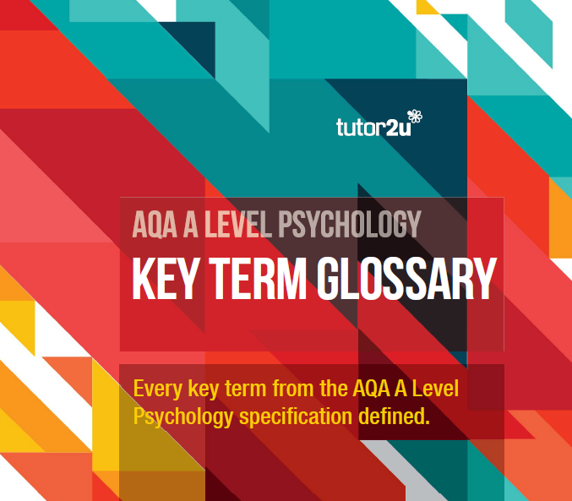
AO1: the knowledge
A glossary of all the key terms is on Teams

Slide 7
AO1: the knowledge

Slide 8
AO1: the knowledge
Online resources – list on Teams
Simply Psychology https://www.simplypsychology.org/
Psychboost https://www.youtube.com/channel/UCqqIPOTshm8EM8CCWkCy9Pg
Tutor2u https://www.youtube.com/watch?v=0PokyYvuL7Q&list=PLp8BSCLLWBUCuyMc0-2cHFid4x1xuXoQM

Slide 9
AO1: the knowledge
If students look for their own online resources, they must check that the material is for AQA A level Psychology

Slide 10
AO1: the knowledge
Other resources:
Text book
Lesson notes
Revision notes
Marked work

Slide 11
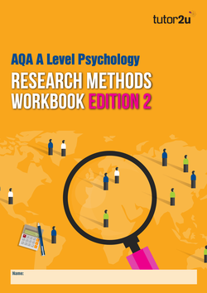
AO2: application of the knowledge
Students have been given a copy of this workbook
Two main types:
Research methods – applying what you know to descriptions of research studies
Applying knowledge to scenarios – we’ll be practising this in class

Slide 12
AO3: evaluation
This takes lots of practice, which we do in class and for homework.
Students often find this the most difficult assessment objective to achieve, but remember that good AO1 and AO2 skills will help you get a good grade.

Slide 13
What does Psychology research tell us about effective revision?

Slide 14
What does Psychology research tell us about effective revision?
Elaborative rehearsal makes it easier to store and recall information

Slide 15
What does Psychology research tell us about effective revision?
What the word looks like
What the word sounds like
The more deeply we think about information, the more likely we are to remember it
What the word means

Slide 16
How does knowing this help?
We can use elaborative rehearsal and deep processing in a range of learning and revision techniques.
Reading notes is better than nothing, but it’s not very deep processing.
It’s not very active.

Slide 17
Active revision techniques
Produce mind maps. It doesn’t matter if the result is messy – you can redraft it. It’s not the pieces of paper you’re left with that’s important, but the process your brain goes through while you decide what to put where.

Slide 18
Active revision techniques
Talk aloud about the information, maybe by revising with a friend. Saying words out loud strengthens the link between it and its meaning.
Working together helps because it makes the process more interactive – keeps you awake.

Slide 19
Active revision techniques
Don’t study any one thing for longer than 45 minutes – concentration wanes after this. Have a short break, perhaps with some time outside, then start again with a new topic or subject.

Slide 20
Active revision techniques
Don’t study two similar things one after the other. Research shows that similar learning/revising similar material will cause interference, one of the explanations of forgetting. For example, revise the multi-store model of memory, then revise another topic or subject before revising the working memory model.
Both of these memory models are on the advance information list

Slide 21
Active revision techniques
Make flash cards – we can provide the cards. You can buy ready made flash cards but the mental process of producing them yourself aids memory. The glossary will be a great help in this. Use the cards to test yourself and each other.

Slide 22
Active revision techniques
Answer lots of questions – I can give you plenty, and you can find some in your text book and workbooks.
Ask your own questions – look at a topic and test yourself on what you know about it.

Slide 23
Active revision techniques
Practise writing out answers within time limits. For each mark you get 1.25 minutes (unless you get extra time) so try to answer a 16 mark question in 20 minutes.

Slide 24
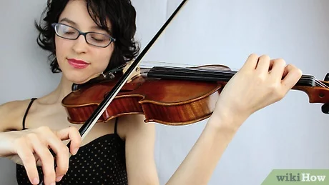
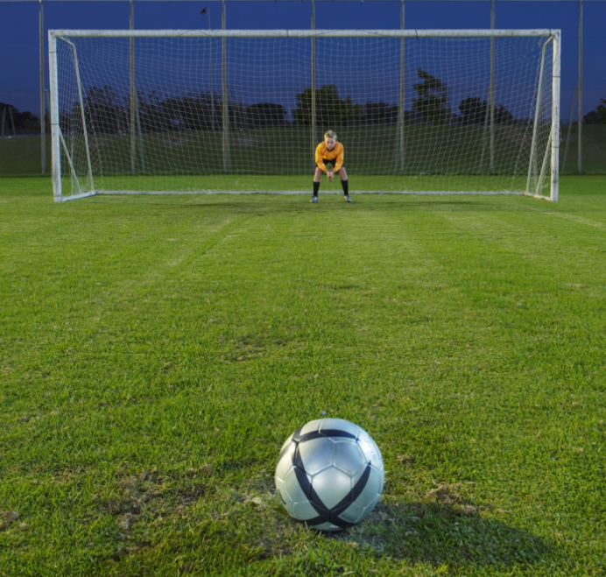
Practise really does make perfect!

Slide 25
Active revision techniques
Getting ready for the mock exams:
We’ll be doing lots of skills practice in lessons – answering AO2 questions, annotating research methods stems, graphs etc.
So if you concentrate on AO1 – learn the facts on all the topics, that will help a lot.

Slide 26
Remember:
You’re all on this side of the IQ distribution curve!
The top 16%

