Slide 1
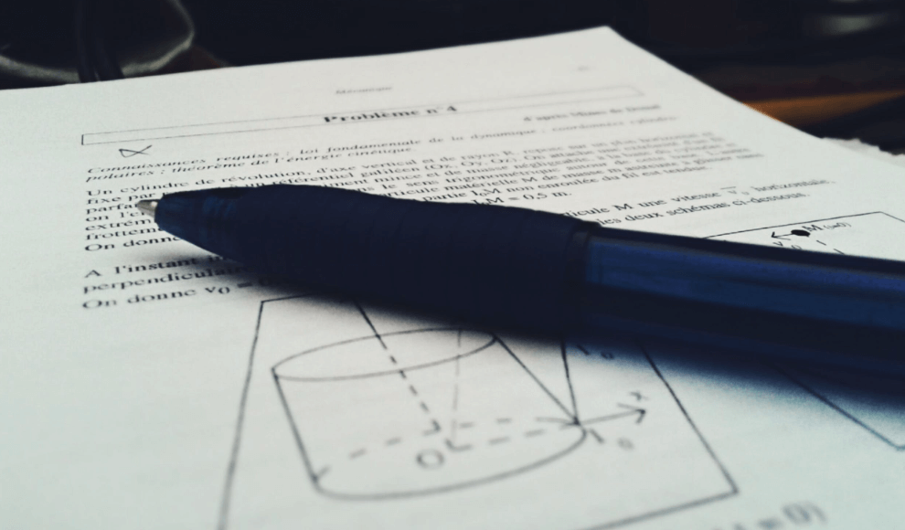
How to revise for A Level Physics

Slide 2
What do we need to do?
How will we do it?
Know
Master
Apply
Interleave

Slide 3
In class we review information and key vocabulary ensuring that students have a concrete basis before applying their knowledge.
Linking together concrete examples to form an overarching knowledge of the specification.
Confidence in knowledge and understanding.
Students must explain science using specific scientific vocabulary.

Slide 4
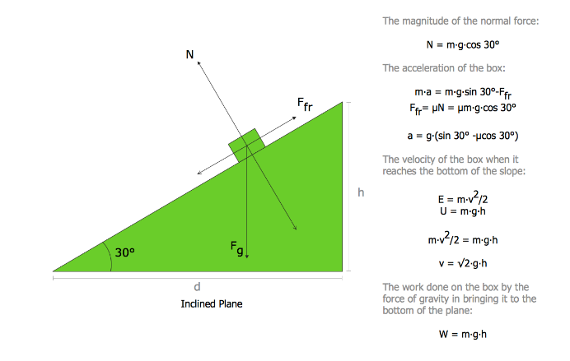
Discussion, questions, talk others through it, work together. Find out where your gaps are and do something about it there and then.
Students must explain content with many levels of detail.

Slide 5
Knowledge recall…
Write everything you know about…
Blank sheets of paper can be scary but can be a great learning opportunity.
Students must explain content with many levels of detail.

Slide 6
Review, break, revisit, break…
The more we do this cycle the greater our knowledge is committed to our long term memory.
This means that it is ‘known’ content and therefore more comfortably applied to both known and unknown contexts.
Students must apply knowledge to both known and unknown contexts.

Slide 7
Active note taking involves turning the material into a different format…
Simply copying notes is passive and limited in impact.
Students must process information to ensure active learning.

Slide 8
Switching between ideas and areas of content is essential to succeeding in A Level Physics papers. This is also great practice for the synoptic aspect of the papers.
The best way to develop this is through completion of past paper questions.
Students must apply knowledge to exam style questions.

Slide 9
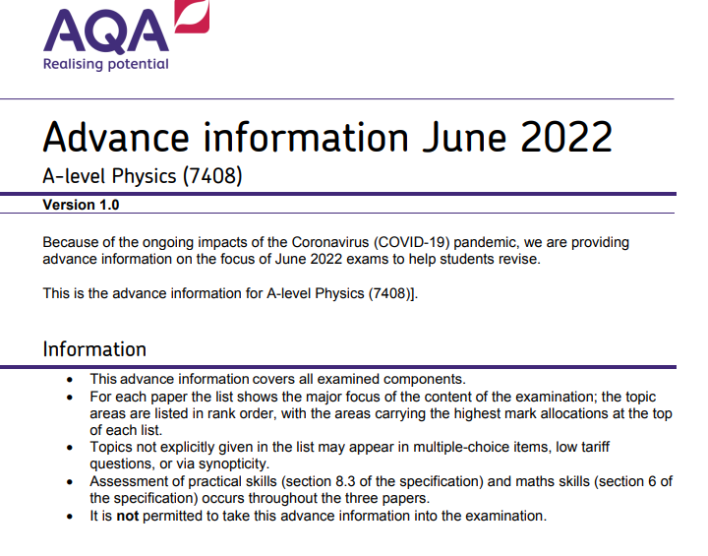

Slide 10
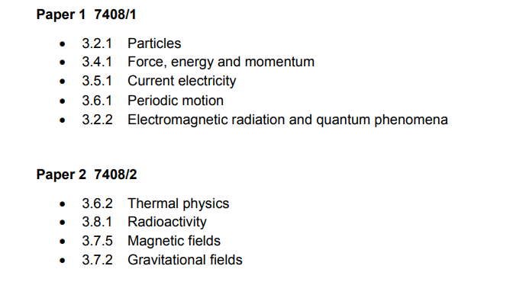
Pre-release information

Slide 11
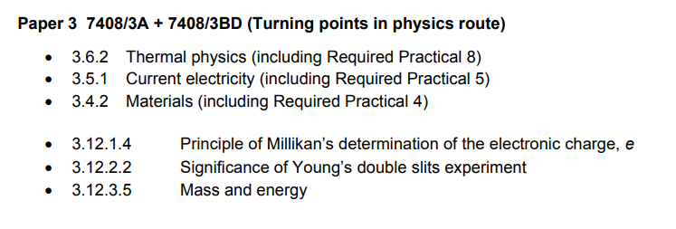
Pre-release information

Slide 12
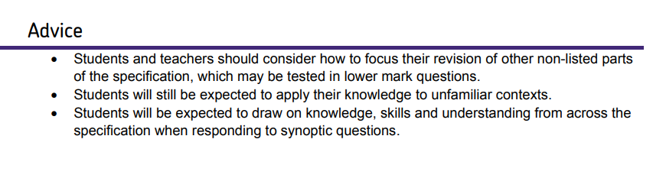
Health warning

Slide 13
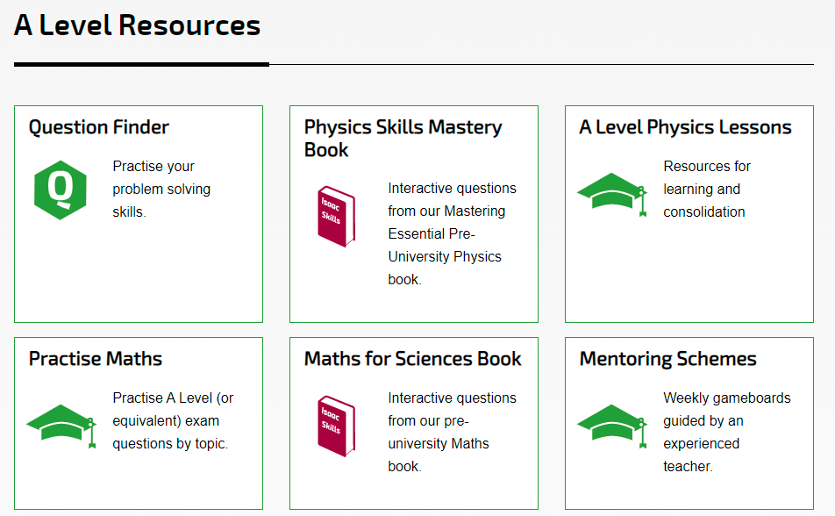
Useful Physics Websites…
Isaac Physics: www.isaacphysics.org

Slide 14
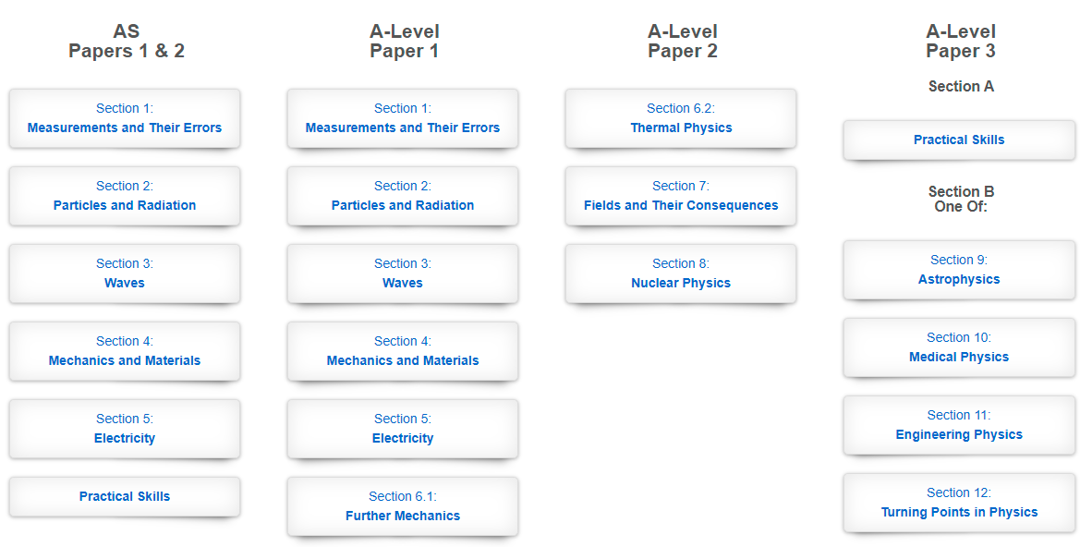
Useful Physics Websites…
Physics and Maths Tutor: https://www.physicsandmathstutor.com/

Slide 15
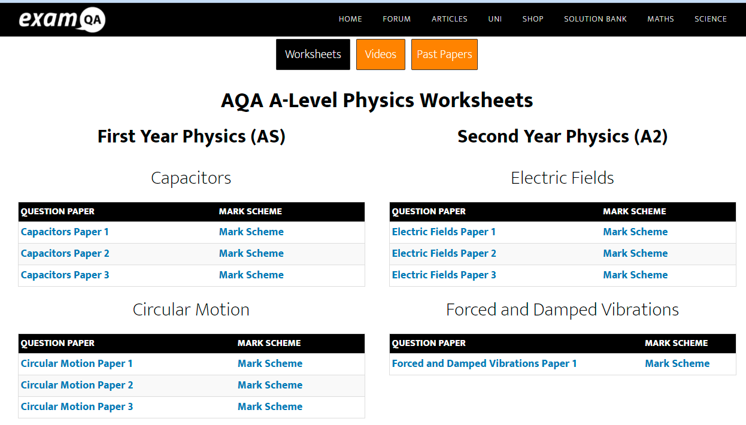
Useful Physics Websites…
ExamQA: https://examqa.com/alevel/physics/

Slide 16
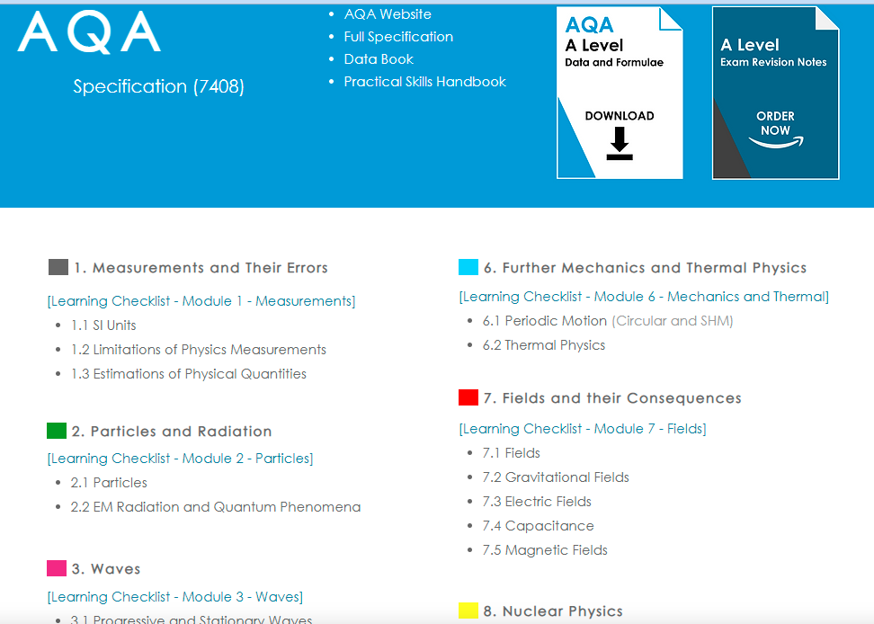
Useful Physics Websites…
A Level Physics Online: https://www.alevelphysicsonline.com/aqa

Slide 17
The key points!
Revision needs to involve active strategies (not just reading!)
Use spaced retrieval and interleaving so that you have to decipher the question content before you begin.
Find full papers on the AQA website:
https://www.aqa.org.uk/subjects/science/as-and-a-level/physics-7407-7408

Slide 18
The key points!
Do as many past paper questions as you possibly can (there’s only so many times they can ask the same questions!)
Avoid specimen papers as the questions are not as high quality.
On completion of exam questions, use both the mark scheme and the examiners’ commentary to gain insights into key difficulties that students faced.

Slide 19
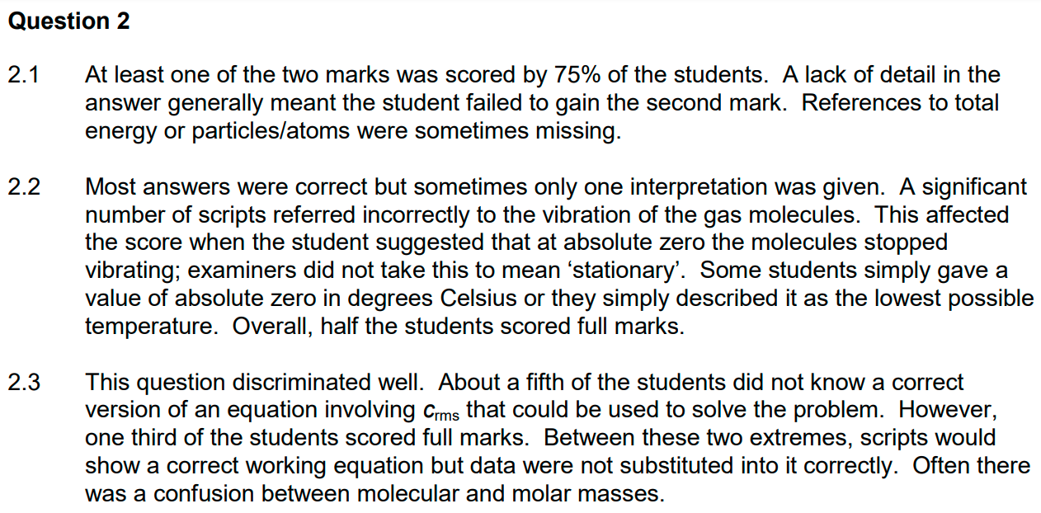

Slide 20
What’s next?
Mock exams
Paper 1 – 10th March
Paper 2 – 17th March
Paper 3 – in class following the mock exam window

