Slide 1
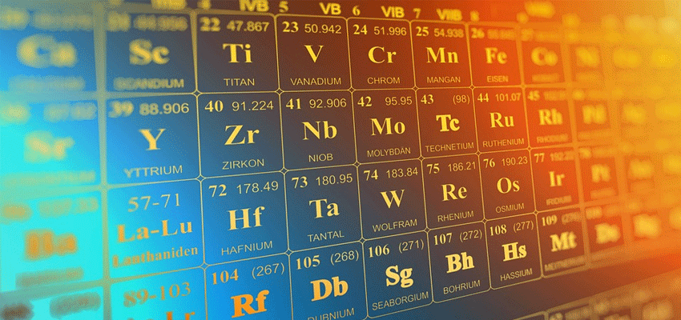
Revising for A Level Chemistry

Slide 15
MECHANISMS!!

Slide 22
Pomodoro technique
Break revision into 25-minute chunks
  No distractions in these 25 minutes!
  Separated by 5-minute breaks
After a few cycles have a longer break
  Gives a sense of urgency
  Potentially less overwhelming at the start of a day

Slide 23
Pomodoro technique
Plan your revision each day (be specific)
  Often best to start with the topics you find the most difficult

Slide 24
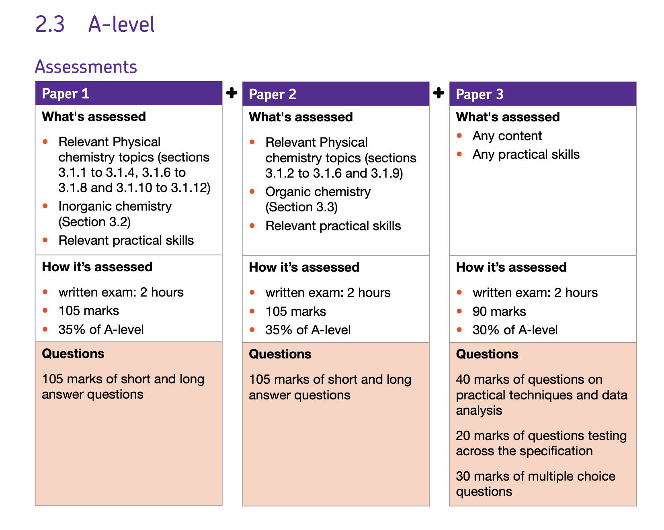

Slide 25
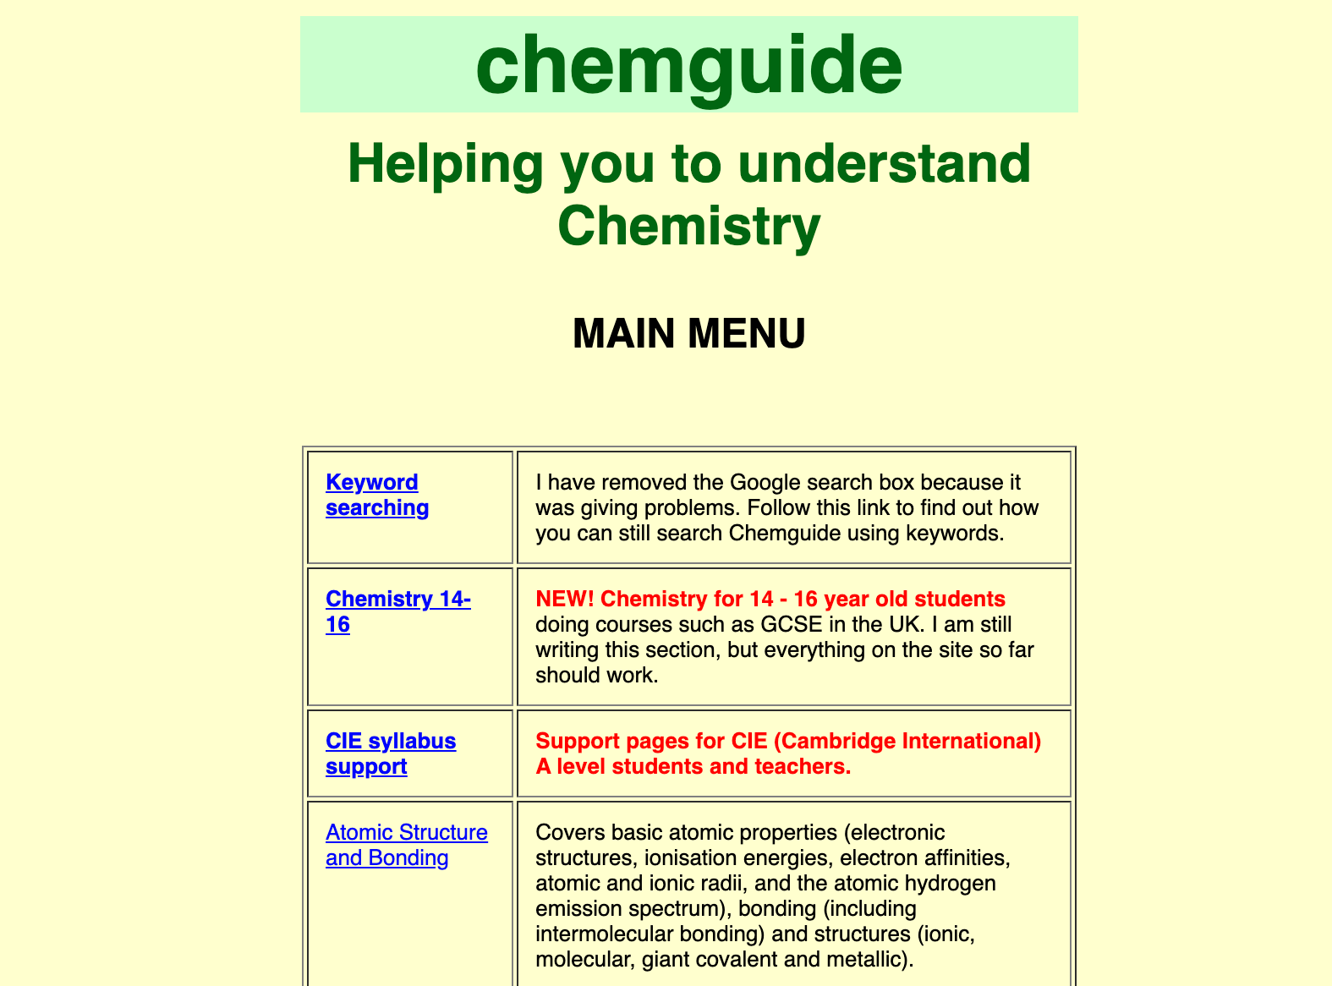
Useful Chemistry Websites
Chemguide: www.chemguide.co.uk

Slide 26
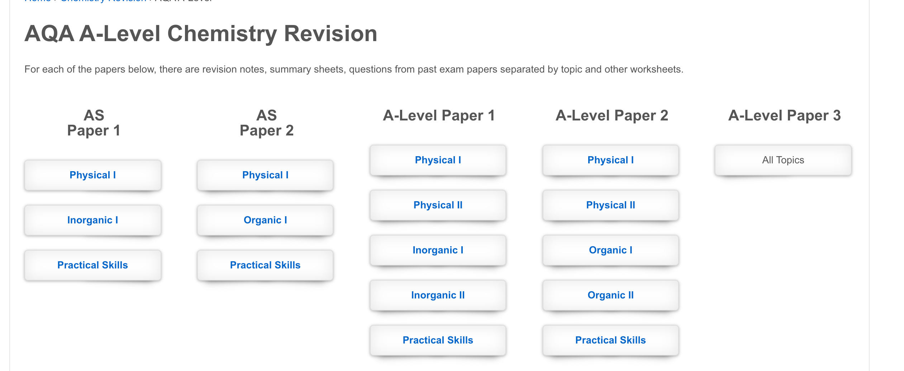
Useful Chemistry Websites
Physics and Maths Tutor: https://www.physicsandmathstutor.com/

Slide 27
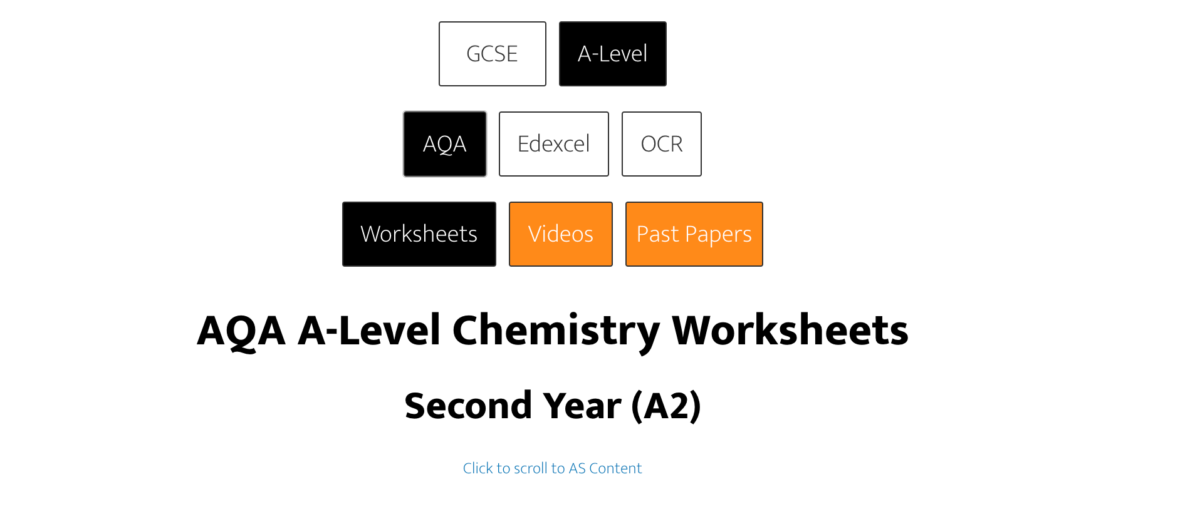
Useful Chemistry Websites
ExamQA: examqa.com/alevel/chemistry

Slide 28
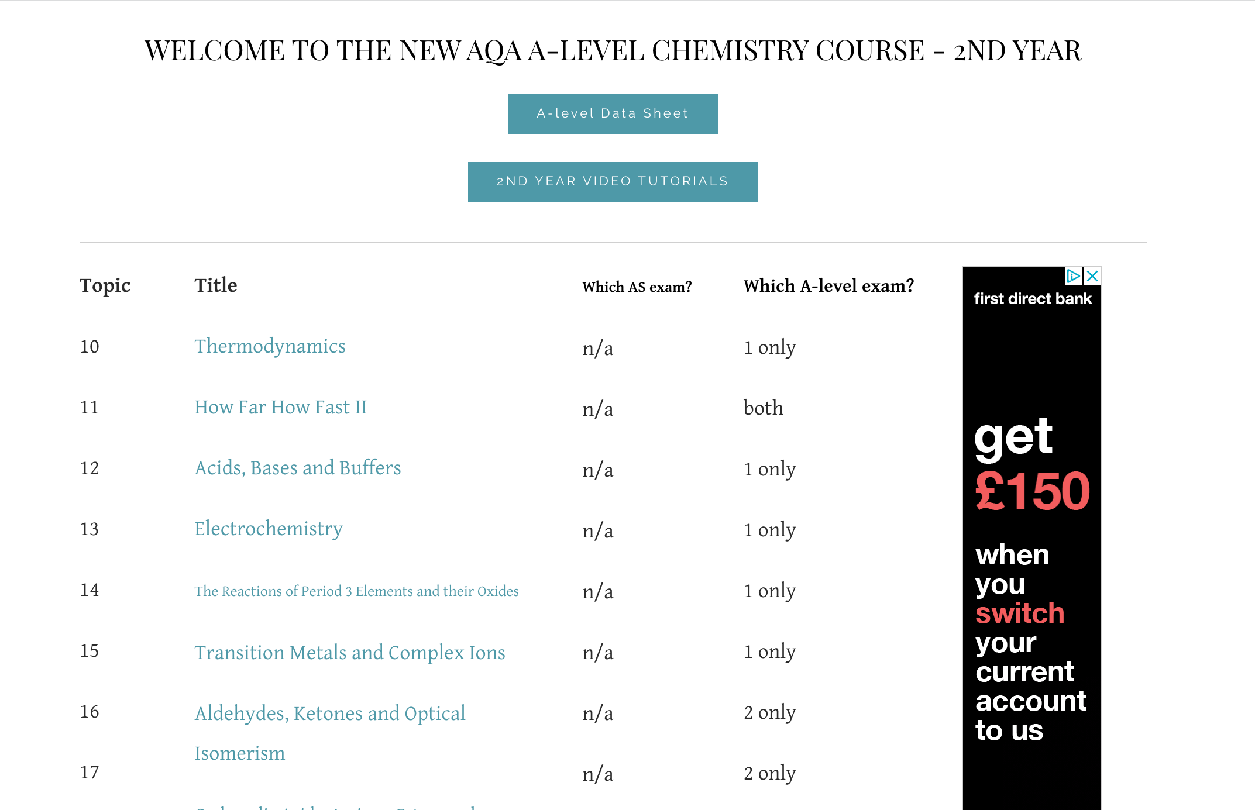
Useful Chemistry Websites
A-level Chemistry: www.a-levelchemistry.co.uk

Slide 29
The key points!
Revision needs to be active (not just reading!)
Use spaced retrieval and interleaving so that you have to decipher the question content before you begin.
Find full papers on the AQA website:
https://www.aqa.org.uk/subjects/science/as-and-a-level/chemistry-7404-7405

Slide 30
The key points!
Do as many past paper questions as you possibly can
Particularly past years rather than specimen papers
On completion of exam questions, use both the mark scheme and the examiners’ commentary to gain insights into key difficulties that students faced.
Revise efficiently!

Slide 31
