Slide 1
Maths

Slide 2
Exams
Foundation Tier – 3 x 90 minute papers
P2 is a non calculator paper
P1 and P3 are calculator papers

Slide 3
Changes for 2022…
Formula sheet
“Content lists” for each paper
…still around 90% of content is on the list!
All will be posted onto Teams after the Spring mock exams

Slide 4
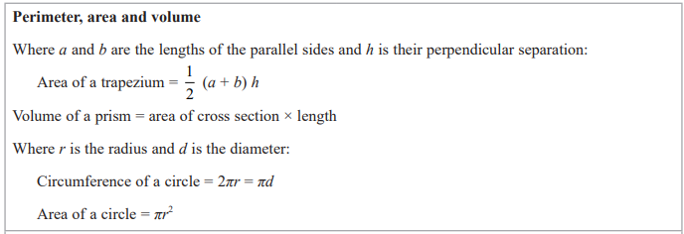

Slide 5
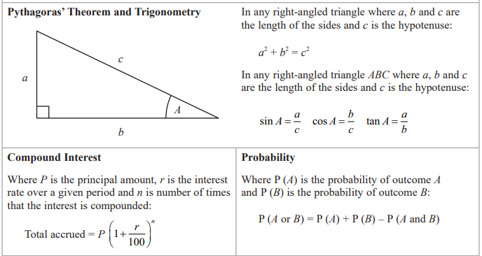

Slide 6
Maths revision
What do I need to know – recall of facts and rules - LCWC
Angle rules
Laws of indices
Speed, density, pressure
Area of a triangle
Convert from a decimal to a percentage

Slide 7
Maths revision
What do I need to be able to do – core skills for each topic
Expand double brackets
Convert between FDP
Simplify powers
Solve simultaneous equations
Convert between units of measure

Slide 8
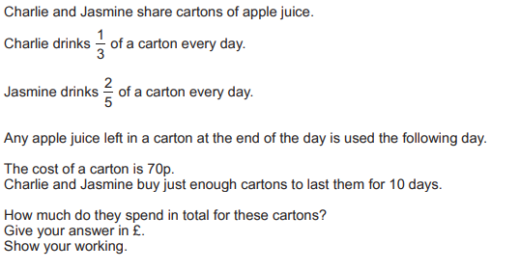
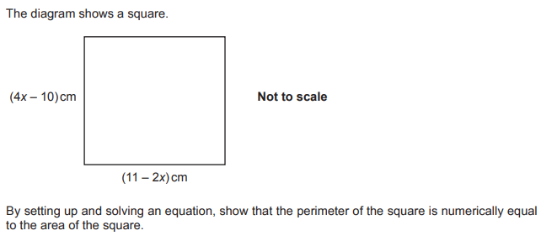
Maths revision
WHEN do I need to use each skill – application to exam questions

Slide 9
Lessons
Key skills sheets: targeted for each skills set and by paper
Exam style practise in lessons: previous exam questions to build familiarity and exposure
Exam papers with full solutions
Outside of lessons
Revision sessions on Tuesday after school
Revision task Tuesday form time
Exam packs (ready for after the mocks) with worked solutions will be uploaded to POD and Teams
HM and video tutorials online
Corbett Maths packs with full worked solutions on Teams

Slide 10
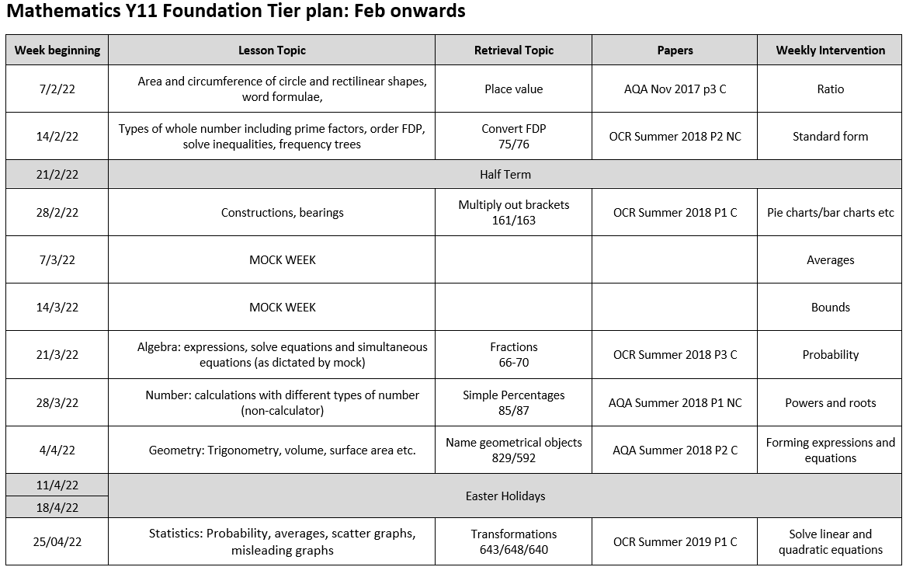

Slide 11
